Slide 1
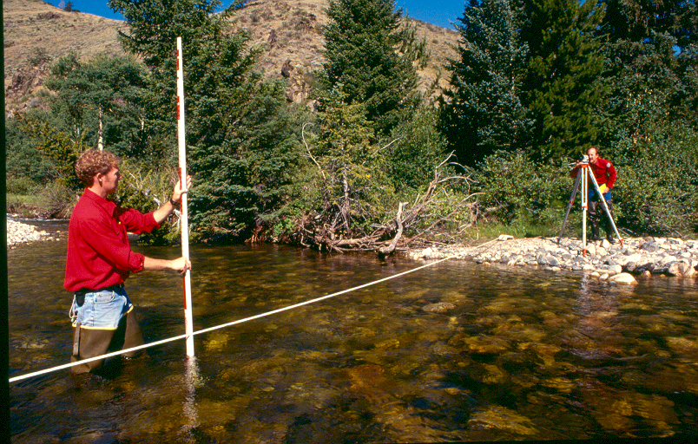
Methods to Quantify Environmental Flow Needs
Notes:
One of the more common ways that instream flow opponents challenge instream flow needs assessments is to question the basis for the recommended amount or claim that there simply isn’t a credible basis for the request. The fact is there are a large number of proven, acceptable methods to chose from for quantifying flow needs. However the challenge is to use the right tool to provide the needed information. This presentation provides some basic information about flow quantification based on some of the more commonly used methods in the U.S. and beyond.

Slide 2
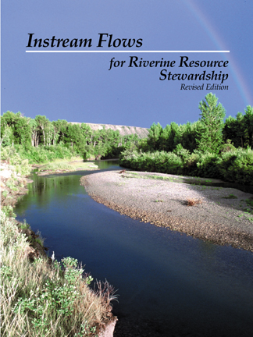
www.instreamflowcouncil.org
Notes:
Most of the information included in this presentation is drawn from publications and policies of the Instream Flow Council. The information in this presentation is very basic but for a more detailed account of the methods discussed and a look at other methods, one can find a thorough treatment in the IFC book Instream Flows for Riverine Resource Stewardship (revised edition) by Annear et al. (2004).

Slide 3
Instream Flow
Science
Institutional Capacity
Public Involvement
Laws & Policies
Notes:
So far, we’ve learned that quantifying and administering effective instream flow regimes is a complicated business involving the combined interaction of 4 primary components. In this presentation, we’ll just focus on the science of quantifying needed instream flow regimes.

Slide 4
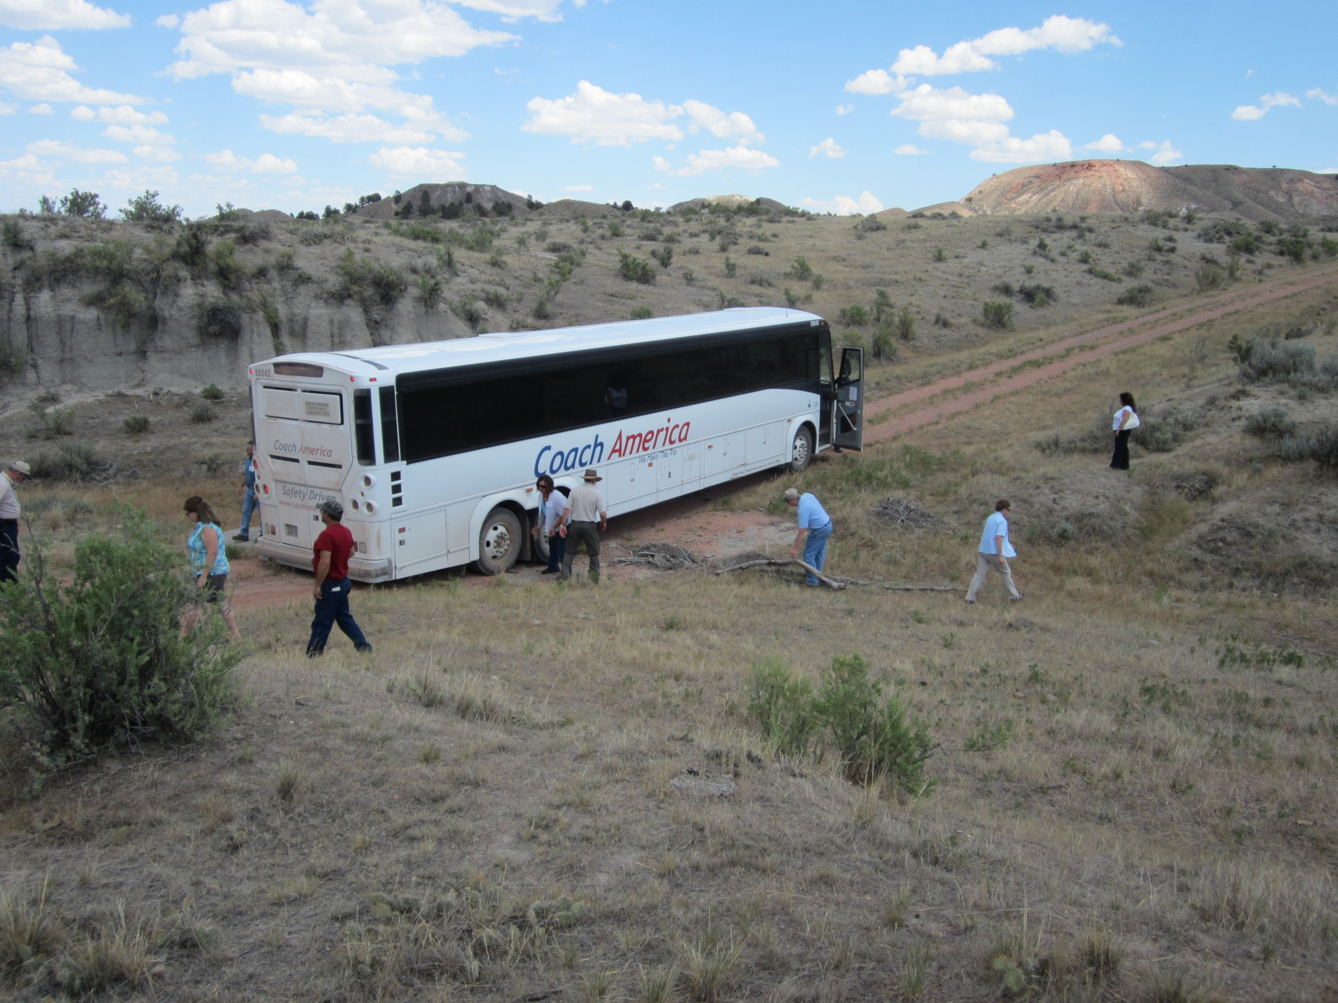
Science is critically important but doesn’t drive the bus!
Notes:
Having the best technical understanding of relationships between flow regimes and ecosystem structure and function is a critically important part of any flow regime quantification process. However, it is important to understand that science is seldom the sole basis for making flow regime decisions. Rather, credible flow quantification is primarily used to help guide the decision making process with the realization that the final decision(s) will likely be based on social values, institutional capacity, and legal limitations and opportunities. Much as some people would like science to be the ultimate decider, such an expectation is really like pounding a square peg into a round hole. People make decisions; not models.

Slide 5
What can models tell us?
A considerable amount about individual habitat elements such as:
    Short-term survival of organisms
    Long-term persistence of habitat
    Long-term persistence of organisms
Notes:
We use models, however, to help us with the decision making process. By selecting appropriate models from the science tool box we can glean a lot of useful information about things like the short-term survival of organisms, the long-term persistence of habitat, and the long-term persistence of organisms.

Slide 6

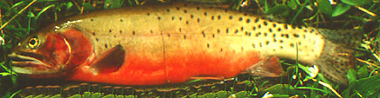
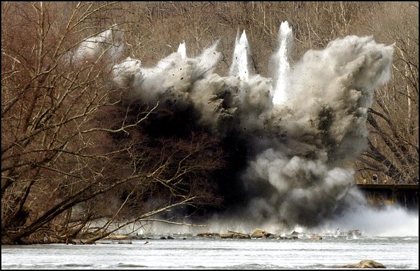
Horseshoes, hand grenades, and instream flow
Do you need to know the PRECISE effect or result?
Or just ACCURATELY predict trends?
Notes:
The discipline of instream flow shares some of the characteristics of horseshoes and hand grenades in the sense that sometimes you just need to come close to the “right” answer. Biologists are commonly asked to predict exactly how many fish will result from a particular flow level and too often they are willing to agree to come up with an answer in part because they love to do science and appreciate the opportunity to do more field work. Unfortunately, there are very few situations where field studies can consistently provide such precision. As a consequence, these “failures” are often used by instream flow opponents as evidence that a flow prescription “doesn’t work” and the recommended flow regime is not valid. In this sense, opponents will always be right and have a potentially powerful tool in their favor if they can just get biologists to play this game. Such precise answers are unrealistic considering that we’re modeling ecosystem processes – just like weather scientists are almost always “wrong” when predicting the weather more than a day or two into the future. But like weather forecasters, we can often provide an acceptable indication of expected trends that will result from various flow regimes.
In spite of this apparent imprecision, our understanding of ecological process does allow us to understand the likelihood of general outcomes pretty well. If used properly, available models and knowledge of ecological processes does allow us to predict trends associated with different flow regimes with reasonable accuracy. As such, it’s important to differentiate between being precise and accurate when quantifying instream flow needs.
The inability or “failure” of science to provide precise answers is definitely not a reason to reject science all together.

Slide 7
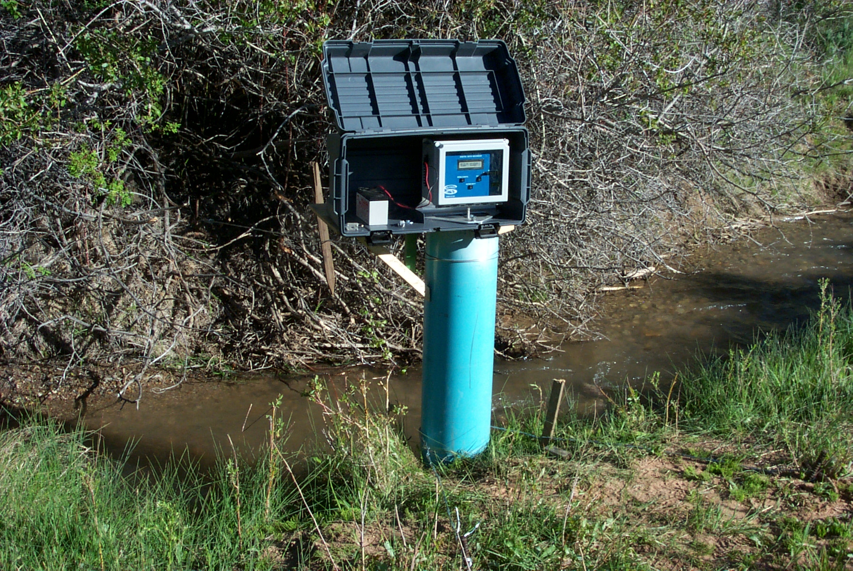
Methods Evolution
1960’s – Water quality
1970’s – Hydrologic statistics
1980’s – Quantitative biology models
1990’s – Ecosystem processes
2000’s – Holistic methods
Notes:
Methods to quantify environmental flow needs have evolved considerably since the first formal recognition of the discipline at the 1976 AFS/AWRA conference in Boise, Idaho.
As the science evolved in the late 60’s and 70’s the focus was primarily on documenting the effects of flow modifications on water quality and changes in hydrologic patterns.
In the 1980’s, the advent of desk top computers enabled scientists to develop models to assess incremental changes in micro and macro habitat needs of fish with changes in flow.
By the 1990’s scientists were looking at more than just fish. Models were developing to address other environmental variables like fluvial geomorphology.
More recently, efforts have been directed at finding ways to link multiple environmental variables to evaluate the effects of flow changes on more than one ecological parameter at a time.
There is still much room for improvement in all these methods, but the up side is that we know much more today about rivers and river processes than we ever have and are much better able to quantify needs than at any other time. This is especially the case when we integrate the output from various models to address specific instream flow questions.

Slide 8
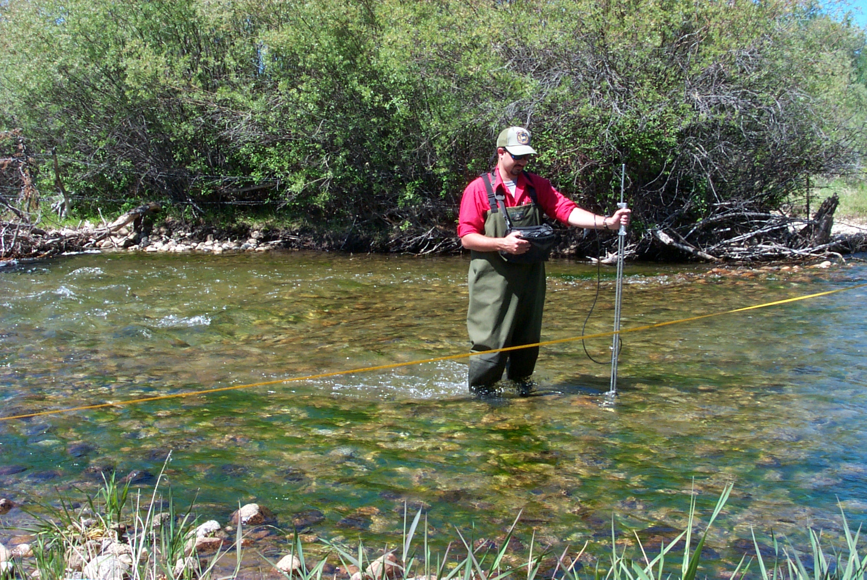
Traditional Approach
One species
One method / tool
One flow (minimum)
Notes:
Traditional approaches to environmental flow quantification were typically fairly simple affairs. Studies often focused on just one species, the application of just one method or tool, and recommendations of a single flow. This approach is still used in many situations today and is referred to as “flat-lining” the flow regime of rivers. But scientists now know that to maintain a fishery, you must maintain all functions of a river and need to do other studies to understand the relationship between the entire flow regimes and riverine structure and function.

Slide 9
Flow quantification methods
Standard-setting methods (segments or regions)
  Single minimum threshold (bottom up)
  Presumptive standard (top down)
Incremental methods
  Evaluate habitat value vs. flow relationship
  Relate to a single riverine element at a time
Multiple component methods
  The next generation
Notes:
Most of the available flow quantification methods can be grouped into one of three types of approaches.
Standard-setting methods are ones that yield a single recommendation that may apply at all times of year.
Incremental methods are capable of identifying trade-offs between flow and habitat values over a range of flows for one riverine element or another.
Multiple component or holistic methods are the latest development in the field of environmental flows and can integrate more than one component at a time.

Slide 10
Habitat Modeling Caveats
Models manage uncertainty – don’t eliminate it.
No model tells us everything we need to know
Relationship between flow & habitat isn’t linear.
A flow that’s good for one species may be detrimental to others.
There isn’t a single “best” flow – think flow regimes.
Notes:
Instream flow models have a few assumptions . . .
Models don’t provide the right, or best, answer. They simply help managers understand the consequences of their actions and thus help manage risk. They don’t eliminate the possibility of making a bad decision.
More water does not necessarily mean more habitat.
A flow that is beneficial to one life stage or species may be detrimental to others
Various life stages and species may require different amounts of water at different times of the year
A flow that maximizes useable habitat in one part of the stream may not provide very much useable habitat in another part
We need to realize that a single instream flow usually isn’t the answer – we need to think in terms of flow regimes.
Modeling output must be evaluated to determine if there are any inconsistent or alarming results.
No one flow is “best” for an ecosystem or a suite of organisms. In almost all situations, we need to manage for flow regimes.

Slide 11
Selecting Methods
Each situation is different so each has a unique solution
Document what questions need answered
Document what questions DON’T need answered.
There’s no such thing as a preliminary recommendation
Notes:
The reason for so many different methods and approaches is due to the fact that each situation is different and we cannot use the same solution for each situation.
As a consequence, each study must begin with its own documentation process of what questions need answered and which ones don’t need answered. Only after this process has been completed should you begin collecting data.
It’s also critically important to bear in mind that there is no such thing as a preliminary recommendation. Unless such an estimate embraces the entire existing hydrograph, such a number runs the risk of becoming institutionalized. And when the number (or regime) is found to be “too low” upon subsequent study, it may be impossible to convince planners and water developers that the needed flow regime must be more than they used for planning purposes.

Slide 12
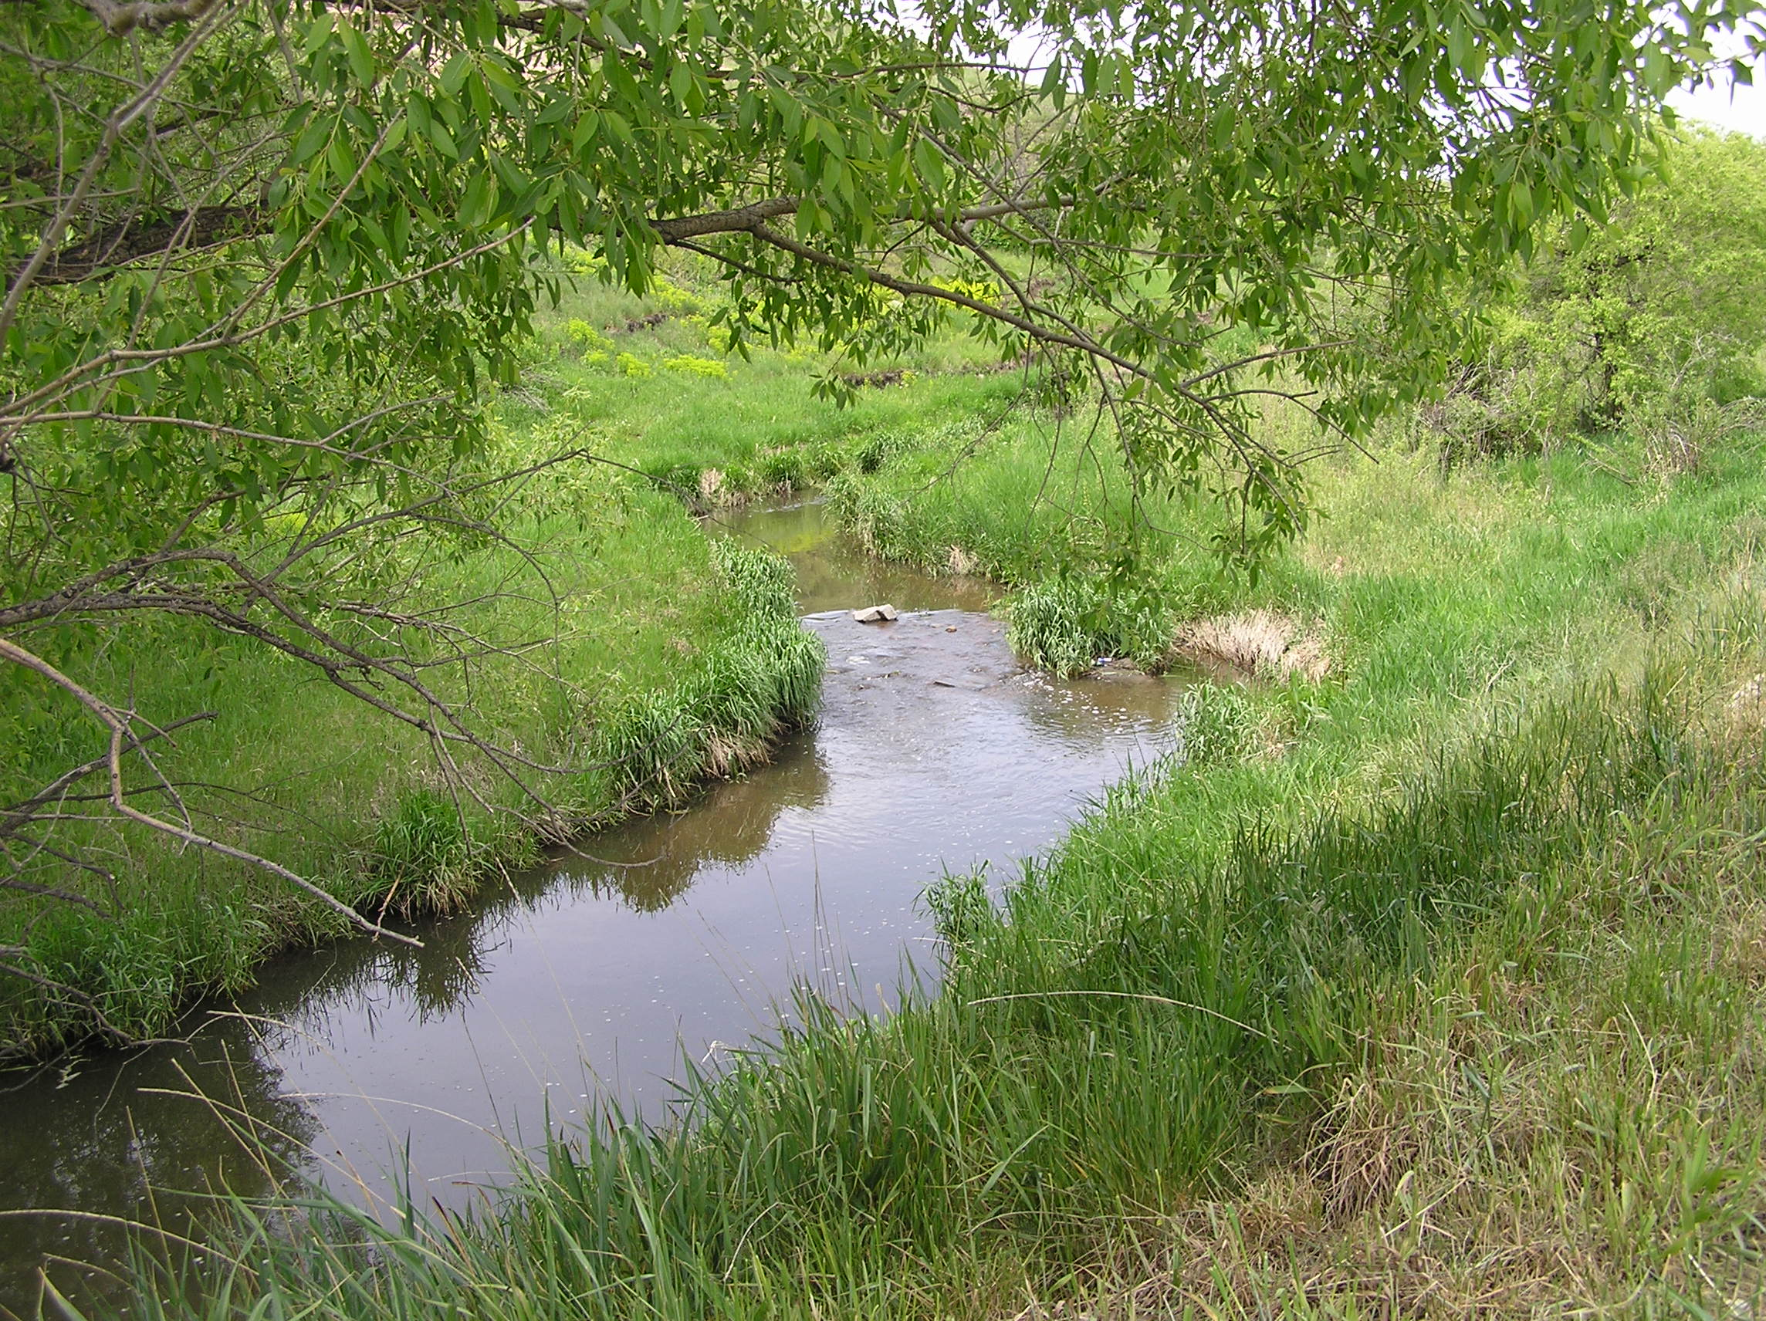
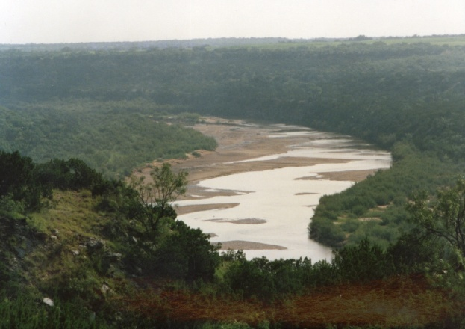
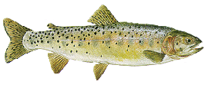
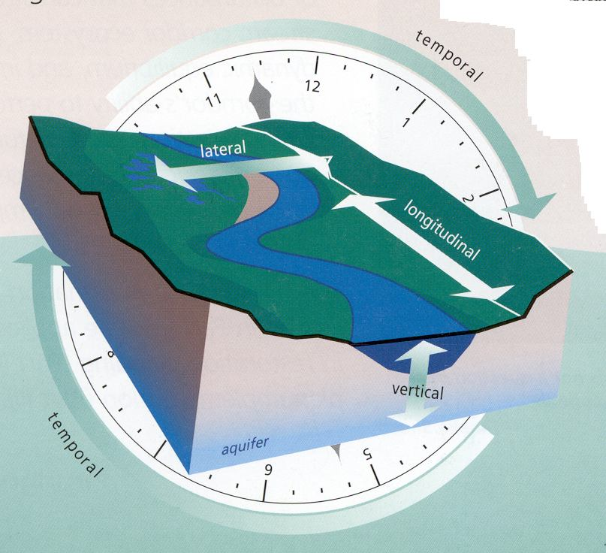
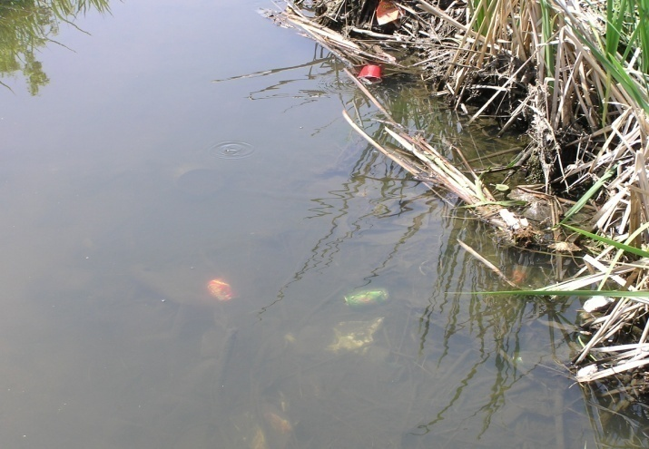
Geomorphology
Biology
Hydrology
Connectivity
Water Quality
Notes:
Instream flow issues can be very complex and we need to acknowledge the potential complexity of any study - but you may not need to know everything about everything.
Understanding the importance and addressing the inter-relations of the 5 riverine components is critical in any flow regime quantification exercise. There is no established approach or methodology to tie all of these fields together nor is there a prescription for which of these components to study. Rather, the challenge is simple to document all your decisions for including or excluding various components in writing and include the justification and approach used in your final report.

Slide 13
Hydrology Methods
Indicators of Hydraulic Alteration (IHA)
Range of Variability Approach (RVA)
Flow duration curves (Q₉₈)
Alberta desk top method
Richter presumptive standard
Notes:
There are a lot of hydrology models to choose from for basing flow recommendations on. Of those shown here, the IHA model is the most widely used tool among IFC member agencies. A couple of the more recent models that have been developed or proposed are the Alberta desk top method and the Richter presumptive standard. These two methods each can be used to protect between 80% and 90% of the instantaneous flow at any time of year and are drawn from biological monitoring that shows that almost any reduction in flow at any time of year will have some ecological consequence.

Slide 14
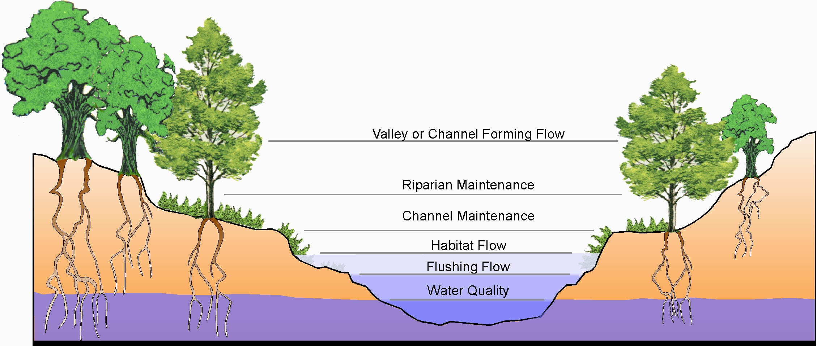
Flow Protection
Upside Down Instream Flow
Notes:
This group of models typically is used to identify how much water you want to leave – not necessarily how much you want to restore. The decision of what to protect can occur at any level of existing flow.

Slide 15
Hydrology Model Considerations
Long history of use (for some) - acceptance
Good for describing hydrology (planning)
Need long-term gage data
Low to moderate effort
Assumes a relationship with biology
May have different relationships with biology on different streams
Need other tools to assess needs for other riverine elements or specific needs

Slide 16
Biology
Single Transect Methods
Tennant Method (and variations)
Physical Habitat Simulation HABSIM
Biological response to flow correlations (HQI)
MesoHABitat SIMulator (MesoHABSIM)
Two Dimensional Models (River 2-D )
Notes:
By far, the majority of instream flow quantification methods are based on some aspect of biology. The methods shown here are among the more widely used.

Slide 17
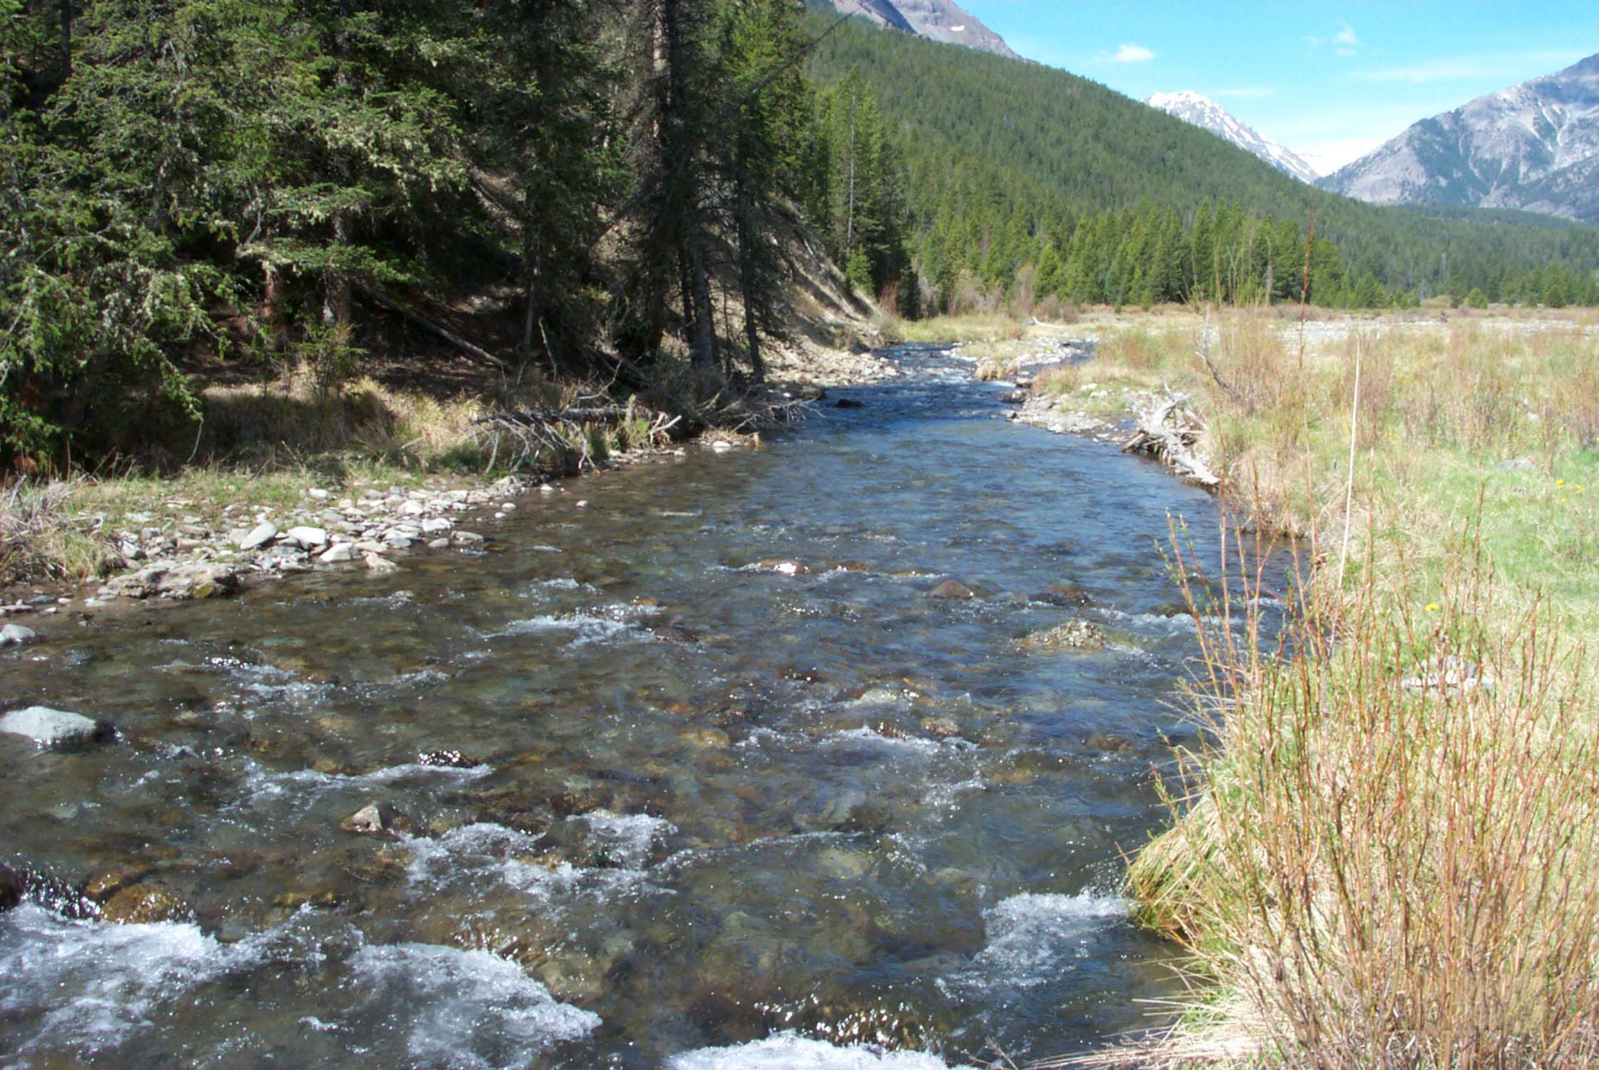
Single Transect Methods
Notes:
Single transect methods were among the first ones developed and are primarily used to estimate hydraulic characteristics over a range of flows. Some the earliest methods were called sag-tape and R-2 Cross, but the calculations of today’s models are essentially the same. Perhaps the most useful hydraulic information was estimated average depth, average velocity, wetted perimeter, and hydraulic radius.

Slide 18
Single Transect Methods
(Wetted Perimeter)
Notes:
In the wetted perimeter method, simulations generate a relationship between the change in the wetted perimeter of a cross section with change in stream flow. A flow recommendation is identified by finding an inflection point in the resultant curve that indicates a point where flow starts to pull away from the stream bank. The method assumes a relationship over a longer stream segment between wetted perimeter at the study site and biological condition. However, not every hydraulic control provides a well defined inflection point which causes the user to become creative in his or her interpretation of the line or forces the user to eliminate that transect from their analysis.

Slide 19
Single Transect Methods
Low to moderate effort
Long history of use
Only useful for setting threshold flows
Limited ability to identify trade-offs
Doesn’t address flow variability needs
Need other tools to assess needs for other riverine elements
Notes:
Single transect methods are useful for setting base or threshold flows and can be conducted with minimal effort. Colorado has based several thousand instream flow water rights on methods like this. This tool does have limitations in that it is incapable of identifying trade-offs between flow and environmental condition, doesn’t address the value and need for different flows in different years and doesn’t address the need for other flows at other times of year for things like geomorphology and water quality.

Slide 20
Tennant Method
Notes:
Many people think of the Tennant (or Montana) method as an office based, single-flow setting tool that is most appropriate in the western U.S. The fact is that Tennant developed this method by doing studies on over 150 streams all across the U.S. – the majority of which were in the Midwest and eastern U.S. Tennant never intended this method to be used only as a single flow estimator in one region of the country. Rather, the method can be used to set seasonally appropriate flow levels. any flow set using the technique should be validated in the field and the tool should be used to establish a range of flows. This method has been used and adapted for use around the world and, according to Mr. Tennant, has never been defeated in a court challenge.

Slide 21
Tennant Method
Can set threshold flows or regimes
Need long-term gage data
Limited ability to identify trade-offs
Majority of challenges have been successfully defended
Need other tools to assess needs for other riverine elements
Notes:
Some of the key characteristics of the Tennant Method include that it can be used to set base flows or flow regimes (though that is often overlooked), and it requires relatively low effort to generate a number. However you typically need a relatively long-term record of flow records (at least 20 years) to come up with a recommendation. A key consideration with hydrology is that if hydrologic patterns have been altered, the recommendation may be artificially lower. One of the method’s strengths is that it has held up well to several court challenges and is a widely accepted method.

Slide 22
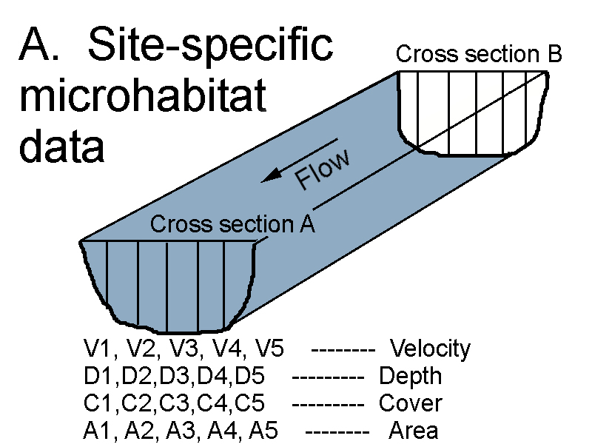
Physical Habitat Simulation (PHABSIM)
Suitability
Velocity
Depth
Suitability
Cover
C. Seasonal relationship between discharge and microhabitat for each life stage
Courtesy Rick Anderson, CDOW
Notes:
The physical habitat simulation methodology is one of the most widely known and used methods available. It is based on a relatively simple hydrologic simulation model that is linked to another set of information called habitat suitability criteria for different species of organisms and life stages. It can also be used for different purposes like aquatic insects, boating and even esthetics. Results are generated in curves contrasting weighted usable area (often improperly called habitat) against flow. As such it is useful to identify tradeoffs in this version of physical habitat at different flows.

Slide 23
PHABSIM Concerns
1-D hydraulic models straighten and simplify the channel
Physical habitat suitability isn’t the same as habitat
Unknown relationship between WUA and fish biomass
Need other models to quantify needs for other riverine purposes
Notes:
Though widely used, this model still has its limitations and problems. Primary among these is that it defines longer segments of rivers on the basis of a limited number of cross sections. The hydrology model only simulates flow in one direction (linear) which is not very realistic in the real world. And the output, that is often referred to as habitat, is really only a portion of habitat that’s defined by depth, velocity and substrate. Though useful, these hydraulic features represent only a narrow definition of habitat as aquatic organisms see it.

Slide 24
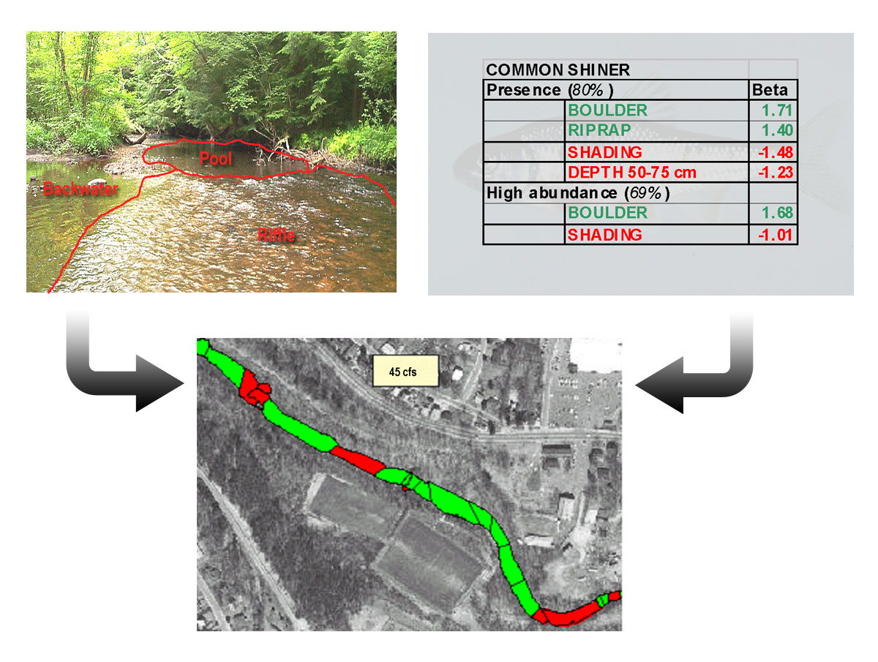
MesoHABSIM
Notes:
MesoHABSIM is a tool that isn’t quite as sophisticated as PHABSIM but may do a reasonable job of identifying larger blocks of habitat over an entire reach of a river instead of just looking at a handful of transects. The data must be collected in the field at each flow of interest and can be a considerable burden and expense. Some critics note that the model is subjective and not repeatable. In some studies the selection of flows needed to achieve project goals is not readily apparent to show lacking intimate familiarity with the model. These concerns are important considerations for any credible scientific tool.

Slide 25
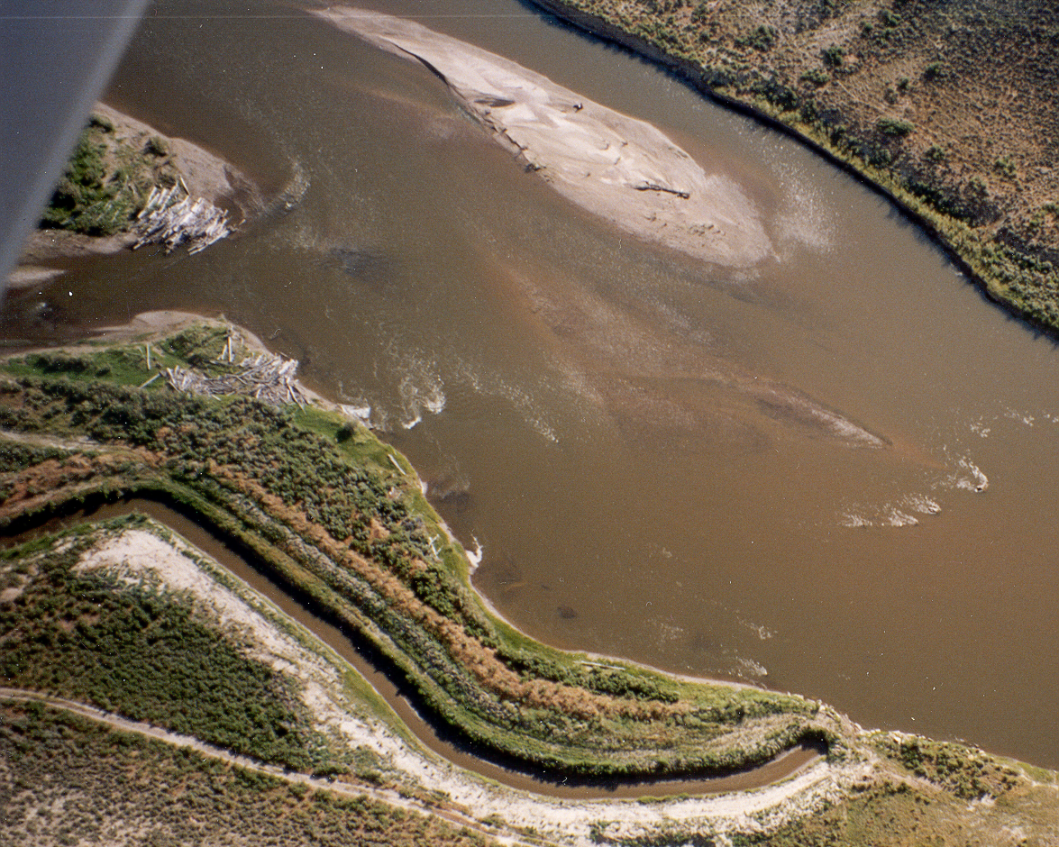
2-Dimensional Physical Habitat Models
flow
Courtesy Rick Anderson, CDOW
Notes:
Two dimensional modeling of riverine habitat is a more recent adaptation of hydrologic modeling and fish habitat. It is two dimensional in the sense that the hydrologic model is more sophisticated and actually simulates the movement of water in horizontal and lateral fields. This is a big improvement over PHABSIM because it allows the user to model more complex habitats in a much more realistic manner.

Slide 26
High-tech field equipment
RTK-GPS & ADP/sonar
GPS & ADP/Sonar Survey
Courtesy Rick Anderson, CDOW
Notes:
This method also relies on collection of data points at much higher densities than one-dimensional PHABSIM modeling that bases analyses only on cross sections. Data collection equipment can be very sophisticated and include use of total station instruments, acoustic Dopler profile equipment and GPS. The large data sets assembled for this tool require considerable computing capability but overall the information gained is detailed and defensible.

Slide 27
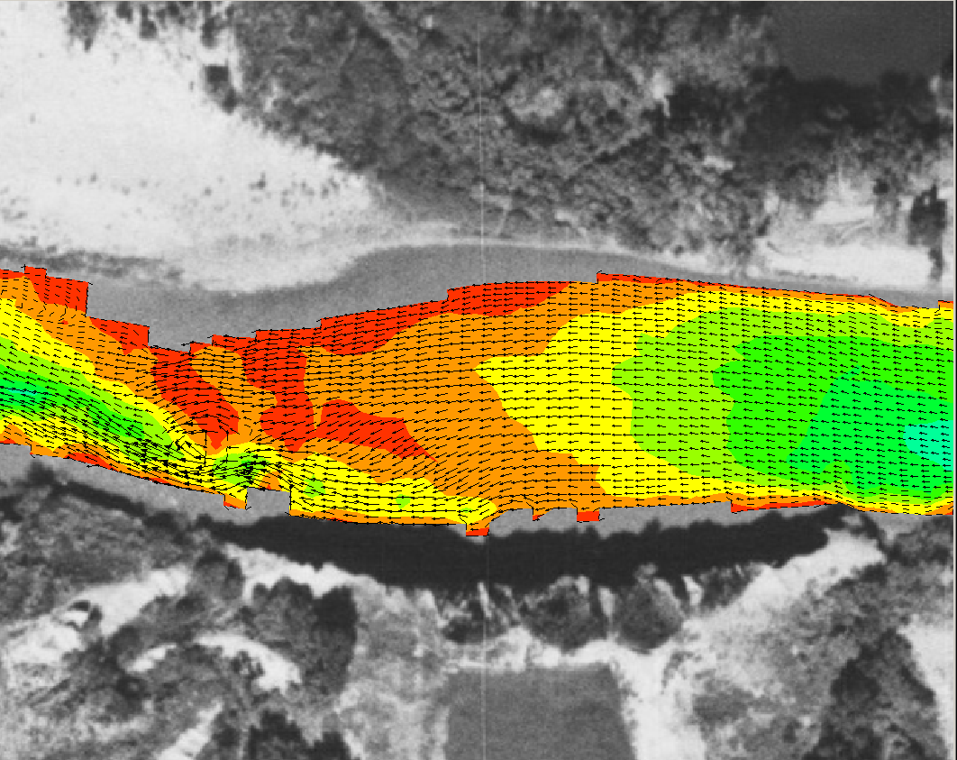
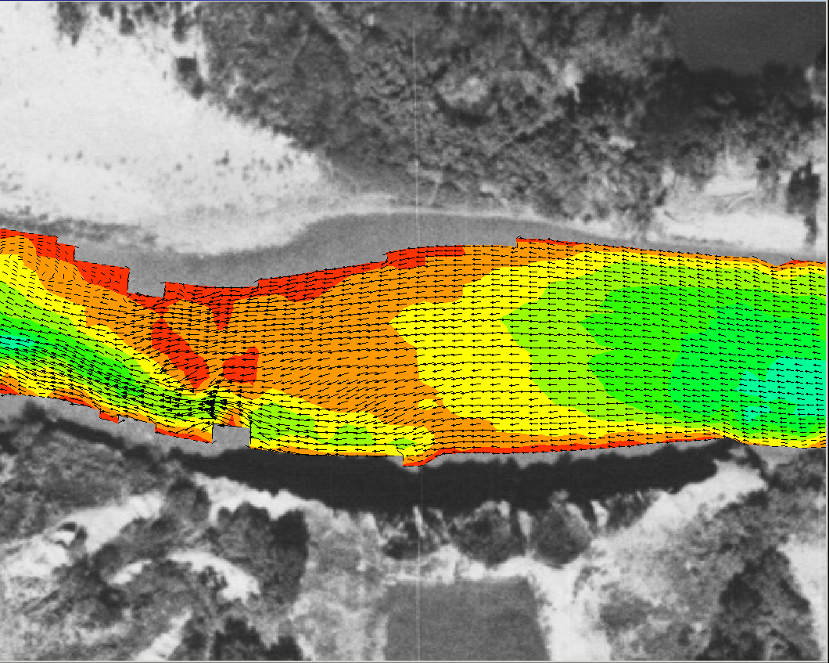
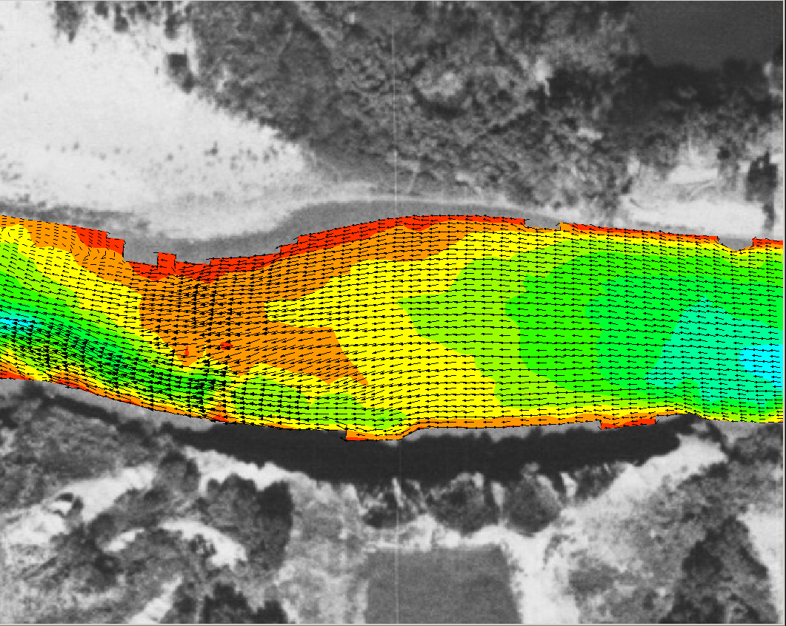
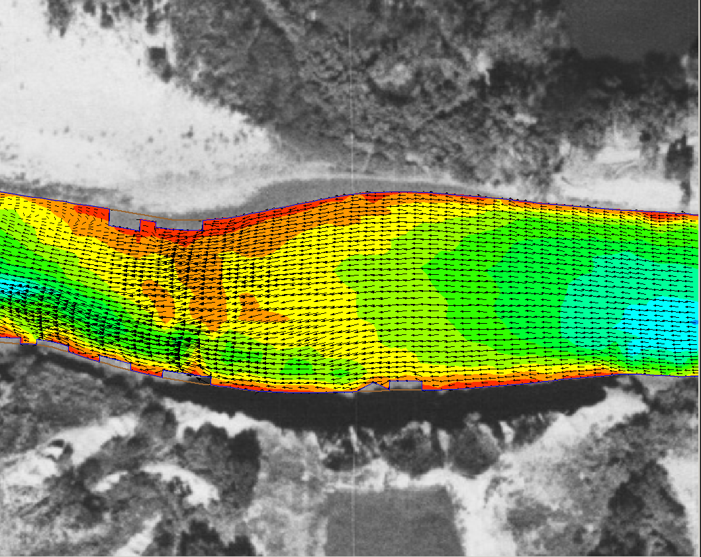

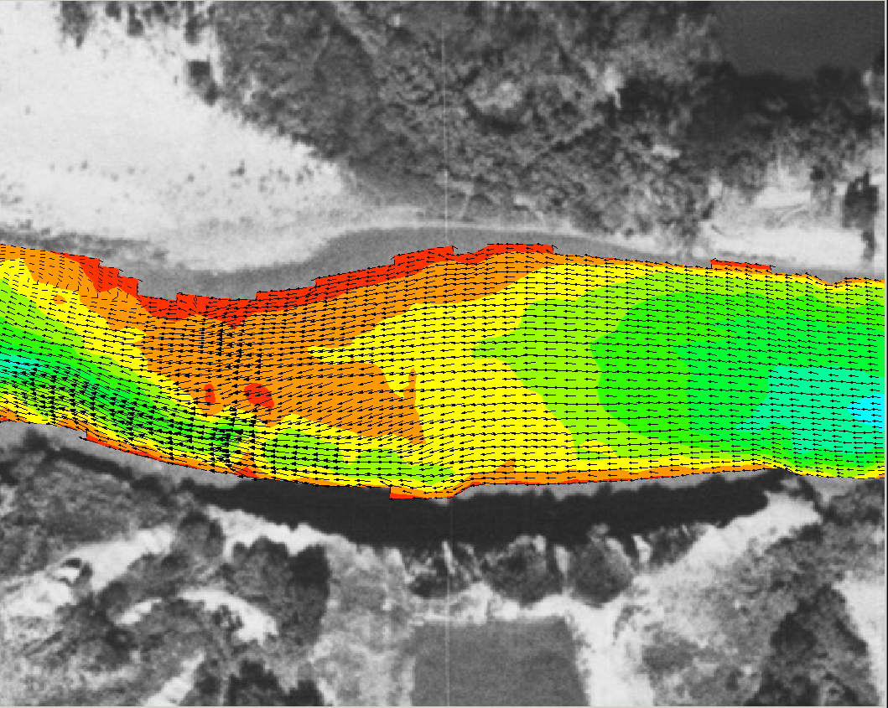
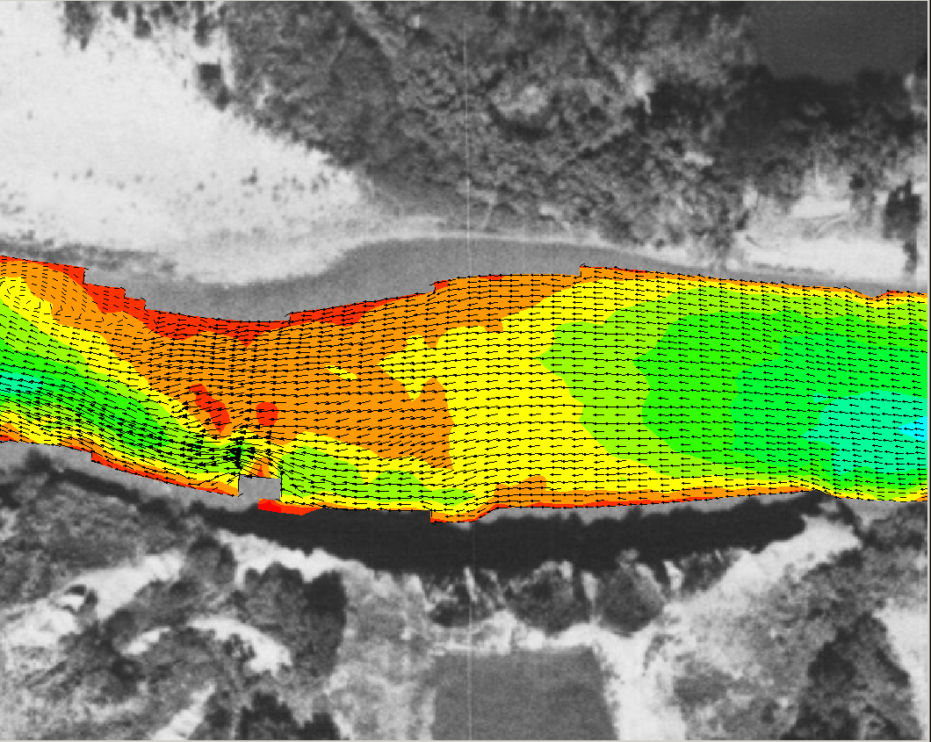
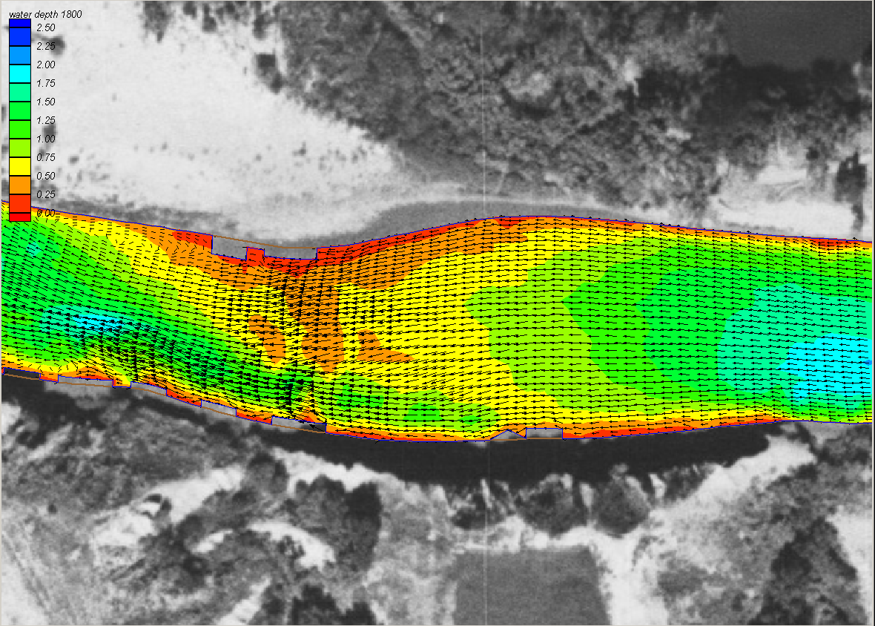
2-D modeling simulates river hydraulics for a flow range
Deep
Shallow
Fast
Slow
600 cfs
800 cfs
1400 cfs
1000 cfs
1200 cfs
1600 cfs
1800 cfs
Courtesy Rick Anderson, CDOW
Notes:
The output of the model is highly detailed and when linked with GIS layering the graphics can be very convincing. In many situations, the imagery that is obtained can show what’s going on much more clearly than the graphs and charts of other models.

Slide 28
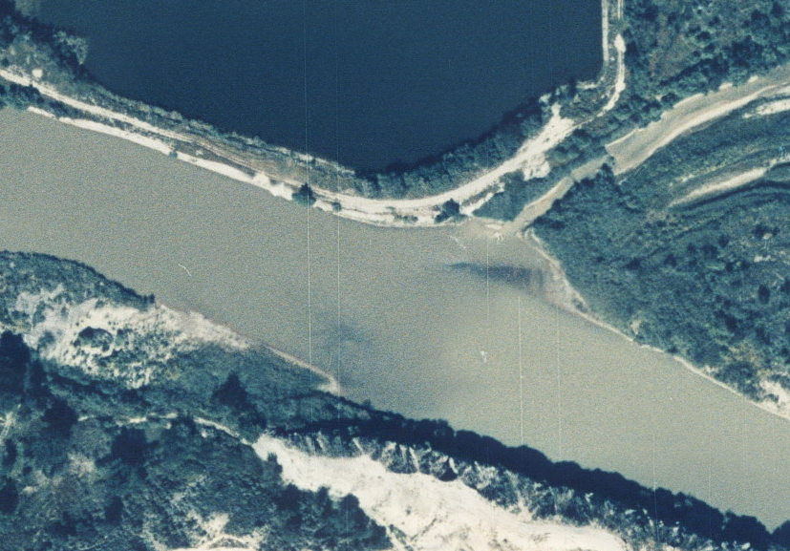
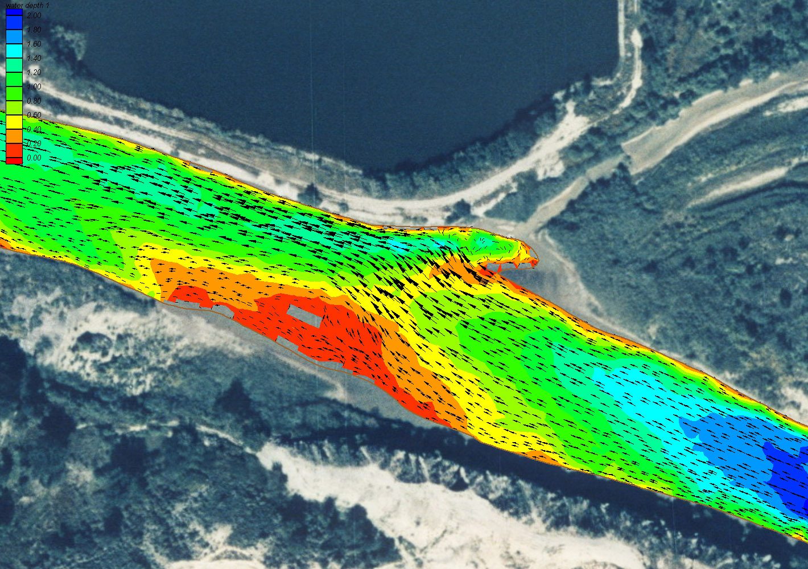
Habitat Mapping
Delineate meso habitat and determine surface area
Determine hydraulic variables (depth and velocity)
Rate the habitats suitability, based on species abundance
Courtesy Rick Anderson, CDOW
Notes:
Once river mesohabitats have been identified they can be delineated on a map of the river and associations of habitat and fish can be displayed.

Slide 29
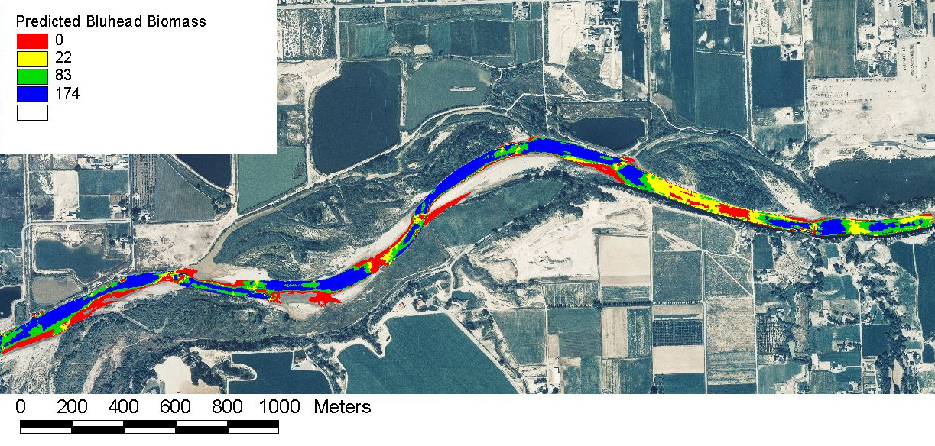
Habitat Suitability
(Kg/m²)
Unusable
Unsuitable
Marginal
Optimal
Courtesy Rick Anderson, CDOW
Notes:
These mesohabitat conditions can then be displayed and summarized for the entire length of river that was surveyed for a range of desired flow levels.

Slide 30
Biology Model Considerations
Many different models available
Focus on survival or habitat suitability (short-term)
Flow / habitat relationship may differ in different streams or stream segments
Some address trade-offs
Need other tools to assess needs for other riverine elements

Slide 31
Flow Restoration
Bottom up instream flow
Notes:
This group of models is often more effective for identifying how much water is needed to restore a fishery. They’re also used to quantify mitigation needs.

Slide 32
Geomorphology
Channel maintenance in gravel-bed streams
Flushing flow
  empirical
  office-based
Geomorphic classifications (Rosgen)
HEC-6 and HEC-RAS
Notes:
A variety of models are also available to provide information about the effect of flow on the movement of bed materials through a stream channel. Many of these are office based tools though most require some field documentation. Among the more popular geomorphology tools are the HEC-6 and HEC-RAS programs that were developed by the US Army Corps of Engineers – Hydrologic Engineering Center.

Slide 33
Geomorphology Model Considerations
Usually have broad confidence intervals
Address long-term physical habitat (not tied to one species)
Need to specify timing, duration, ramping
Need other tools to assess needs for other riverine elements
Notes:
Things to think about when using geomorphology models include the fact that they are often not very precise – model results typically have broad confidence intervals and require field validation.
These models serve to identify processes that maintain long-term physical habitat needs (and sediment transport equilibrium) but aren’t necessarily tied to one species.
The results are not time specific which means you need to specify the timing duration and ramping (change in flow) patterns based on the results of your model.
As with other riverine elements, you need other methods to identify flow needs for other riverine elements.

Slide 34
Water Quality
Stream System Temperature (SSTEMP)
Stream Network Temperature (SNTEMP)
QUAL2E (and K)
7Q10
Notes:
Water quality tools have been around for over 50 years and advances continue to be made in these models. Though most of these models are not used as stand-alone tools to prescribe instream flow levels, it’s interesting that the most conservative of these models has been used with relative frequency as a basis for setting flow levels. The 7Q10 (the lowest discharge that occurs over 7 consecutive days with a 10 year recurrence interval) has often been used for this purpose (mostly in the eastern and southern U.S.) but it is important to bear in mind that this is not an instream flow method with any value for protecting or restoring biological aspects of a river. It is strictly a method that relates to maintaining established water quality standards.

Slide 35
Water Quality
Addressed long before water quantity
Don’t address intra- or inter-annually variable flows or processes
Don’t directly identify trade-offs with biology
Need other tools to assess needs for other riverine elements and processes

Slide 36
  Maximum flow
Minimum flow
Water quality models typically relate to minimum flows . . .
Notes:
Effective instream flows include more than keeping a minimum amount of water in the stream to maintain fish survival.
Once minimum flows are set, they ultimately become maximum flows above which flow seldom ever rises again. To provide meaningful, long-term ecological protection, it’s essential to at least talk in terms of instream flow regimes for multiple purposes whether they are achievable in the short term or not.

Slide 37
Connectivity Methods
Two dimensional models can address this at the segment level
Some groundwater models address this
Estuary methods
  Salinity-based inflow method
  Tidal distributary method
Visual inspection
Notes:
Connectivity can be addressed via several models though none of them is usually described as solely a connectivity model. At the stream segment scale, two-dimensional models can be conditioned to identify the flow or flow at which prescribed connectivity processes occur.
Likewise, several groundwater models including SSTEMP and SNTEMP include a factor to address connectivity.
Certain estuary models including salinity-based inflow method and the tidal distributary method are based on connectivity of inflows from associated rivers but the application of these models is probably limited to the reach level.
Lastly, investigators can generate connectivity information from relatively low technical visual surveys of the stream at different flows. This kind of information may not be derived from simulations but can be valuable nonetheless.

Slide 38
Connectivity
Specify which of 4 dimensions you’re using (lateral, vertical, longitudinal, time)
Identify which elements are of interest (organisms, chemistry, bedload, energy)
Specify time and duration when needed
Need other tools to assess needs for other riverine elements and processes
Notes:
Connectivity is potentially one of the more complicated of the five riverine elements. You must not only quantify or recognize four dimensions, but also address connectivity of different physical, biological, and energetic components. It is also imperative to specifically address issues related to seasonal periodicity, ramping, and duration. As with all riverine elements, other tools are needed to assess needs for other riverine elements and processes.

Slide 39
Holistic Methodologies
Downstream Response to Imposed Flow Transformation (DRIFT)
Ecological Limits of Hydrologic Alteration (ELOHA)
Bayesian Decision Models
Demonstration Flow Assessment (DFA)
Notes:
In the past decade or so, several tools have evolved to begin to address flow needs from a more holistic, community-based perspective. It seems likely that this trend will continue. A few of the more widely recognized approaches include the following.
The Downstream Response to Imposed Flow Transformation (DRIFT) Framework uses four modules: Biophysical, socio-economic (how common users are affected), scenario building, economics (strict monetary cost).
Decision Flow Assessments involve groups of experts agreeing on important riverine attributes or characteristics that change with flow and then making collective judgments on how those attributes actually change with flow
Ecological Limits of Hydrologic Alteration is designed to build on models like the IHA and add a biological realism that is lacking with just hydrologic statistics alone. One of the limiting factors to this tool is the general absence of credible ecological data to validate the assumptions
Bayesian Decision Models are the latest in this evolving trend. They involve a combination of data and judgment but develop decision pathways based on probability outcomes rather than precise calculations of outcomes.

Slide 40
Ecological Limits of Hydrologic Alteration (ELOHA)
Links hydrological alteration (IHA) with ecology
  Requires good hydrological data
  Requires information about ecological processes
Notes:
One method drawing particular attention is the Ecological Limits of Hydrologic Alteration (ELOHA) approach. Touted as a method, this tool is actually better described as a template for conducting detailed studies. ELOHA begins by appropriately using models the IHA to describe the existing and anticipated hydrologic regime but faces the same challenges as other models when it comes time to add a measure of biological realism – the pervasive “black box” that ties hydrology to ecologic processes. The general absence of credible ecological data to validate the assumptions used in this approach is a major issue.

Slide 41
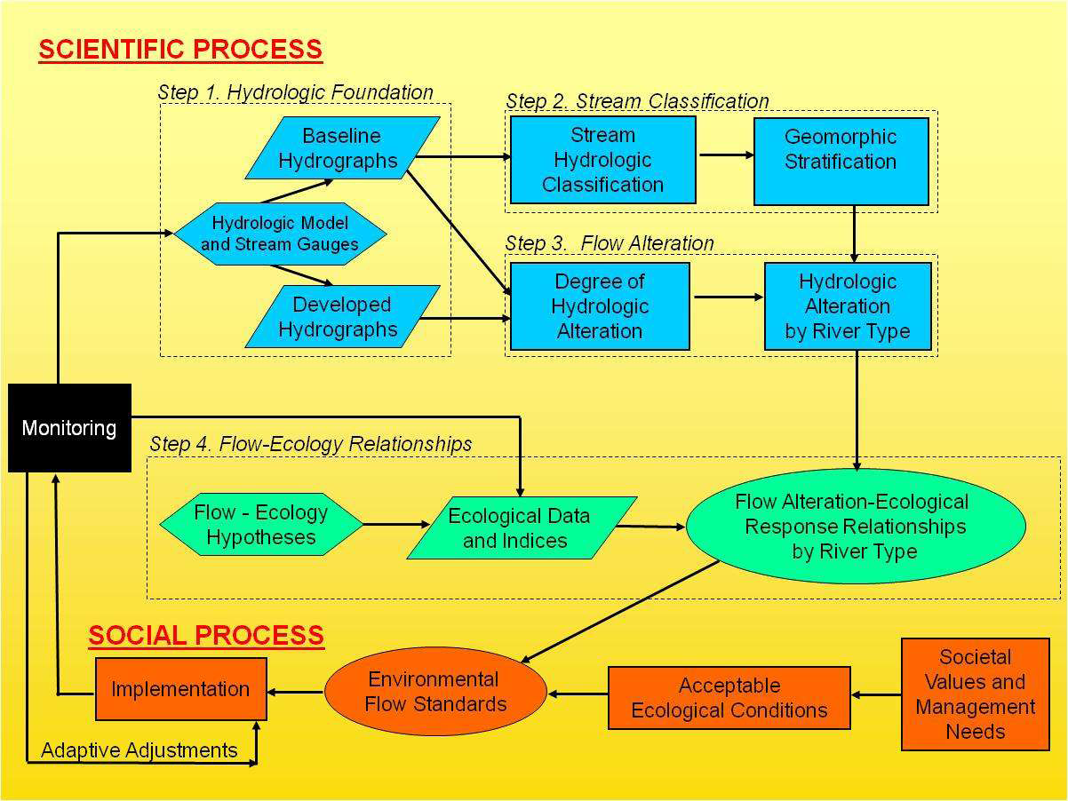
Ecological Limits of Hydrologic Alteration (ELOHA)
Notes:
ELOHA provides a decision-making process more than represents a discrete replicable model.

Slide 42
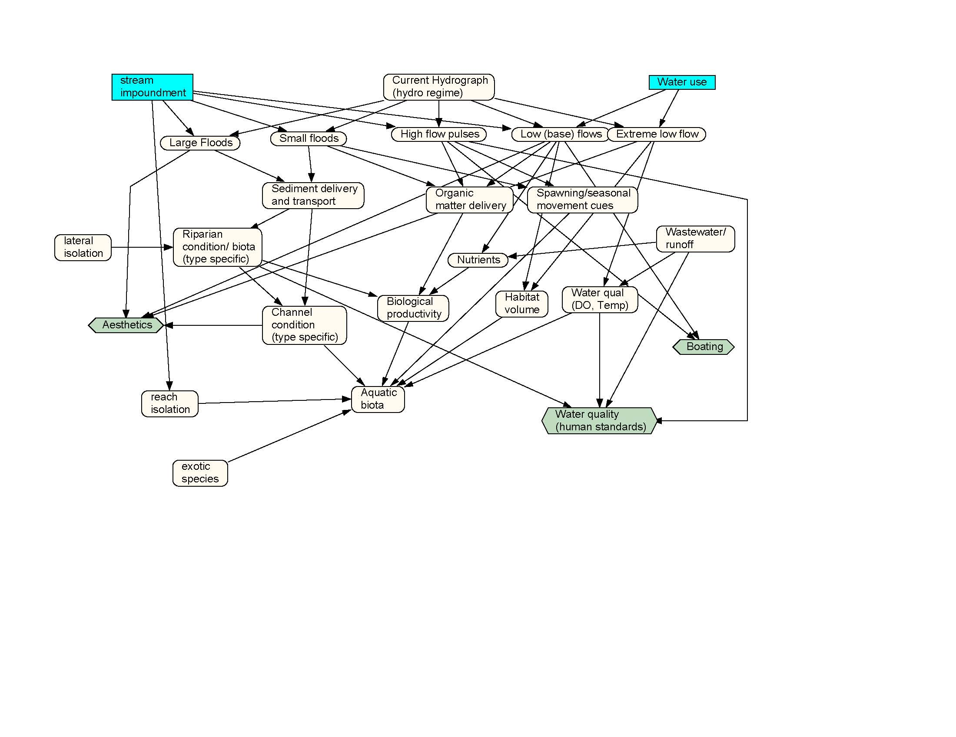
Bayesian Decision Models
Notes:
Bayesian Decision Models are the latest in this evolving trend. They involve a combination of data and judgment but develop decision pathways based on probability outcomes rather than precise deterministic calculations of outcomes.
Bayesian decision models are essentially probability assessment tools. They can be as complex as one wishes to make them and can be designed to address any number of inputs and outcomes. They are intriguing because they can be worked both forwards and backwards to adjust variables as appropriate. This particular draft model for the Flint River, Georgia included consideration of the 5 riverine components identified by the IFC, but is still a relatively simple representation of nature. As with all models, these too can be and are limited by the quantity and quality of information that is available.

Slide 43
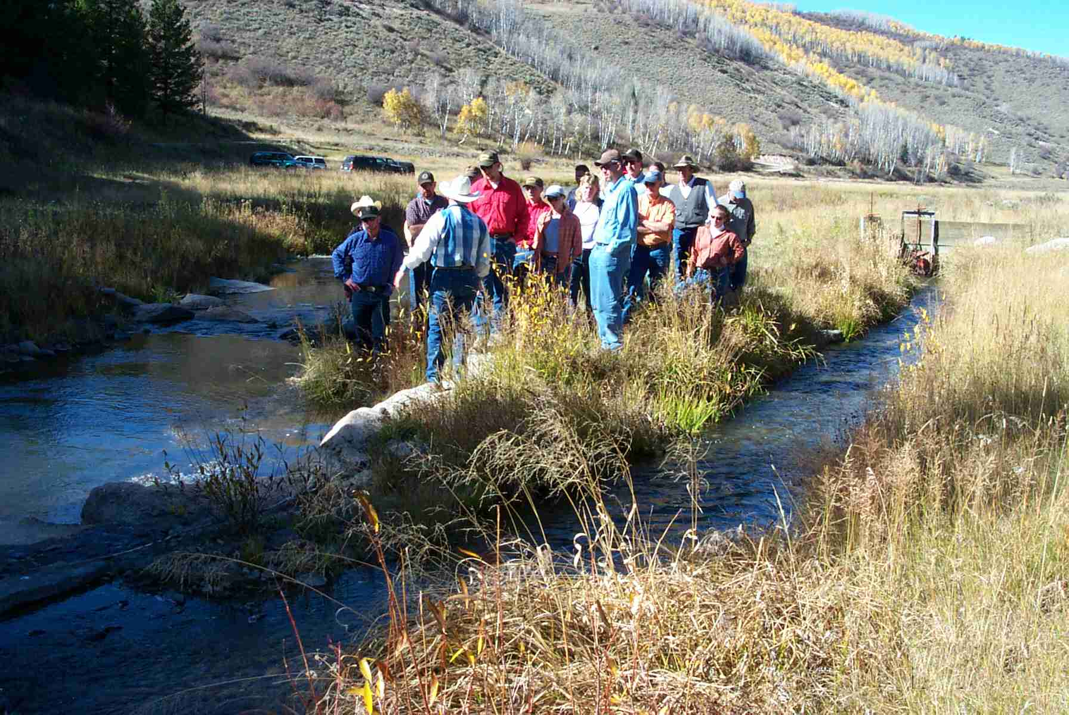
Demonstration Flow Assessment
Notes:
Demonstration Flow Assessments are a technique that is occasionally used when funds are limited, the risk of error is somewhat less, and there is either difficulty collecting data or a lack of faith in the data that will be collected. It involves assembling a team of experts who are skilled at understanding the riverine components of interest. This technique is sometimes jokingly referred to as a BOGSAR (bunch of guys standing along a river) but in reality this can and should be a scientifically controlled exercise. As such, the team must strive for a process that can be repeated by another similarly skilled group of individuals. This tool has a benefit that, if done properly, it can generate buy-in from all stakeholders who participated in the decision-making process. This approach is described in more detail in the IFC book “Instream Flows for Riverine Resource Stewardship, revised).

Slide 44
Holistic Model Considerations
Still address limited range of elements
Biological outcome is the weakest link
Method development and refinement is a high priority
“Ecosystem modeling” requires large amount of data
Notes:
Holistic methodologies hold great promise. Developing tools that integrate multiple components is perhaps the greatest research need for scientists today

Slide 45
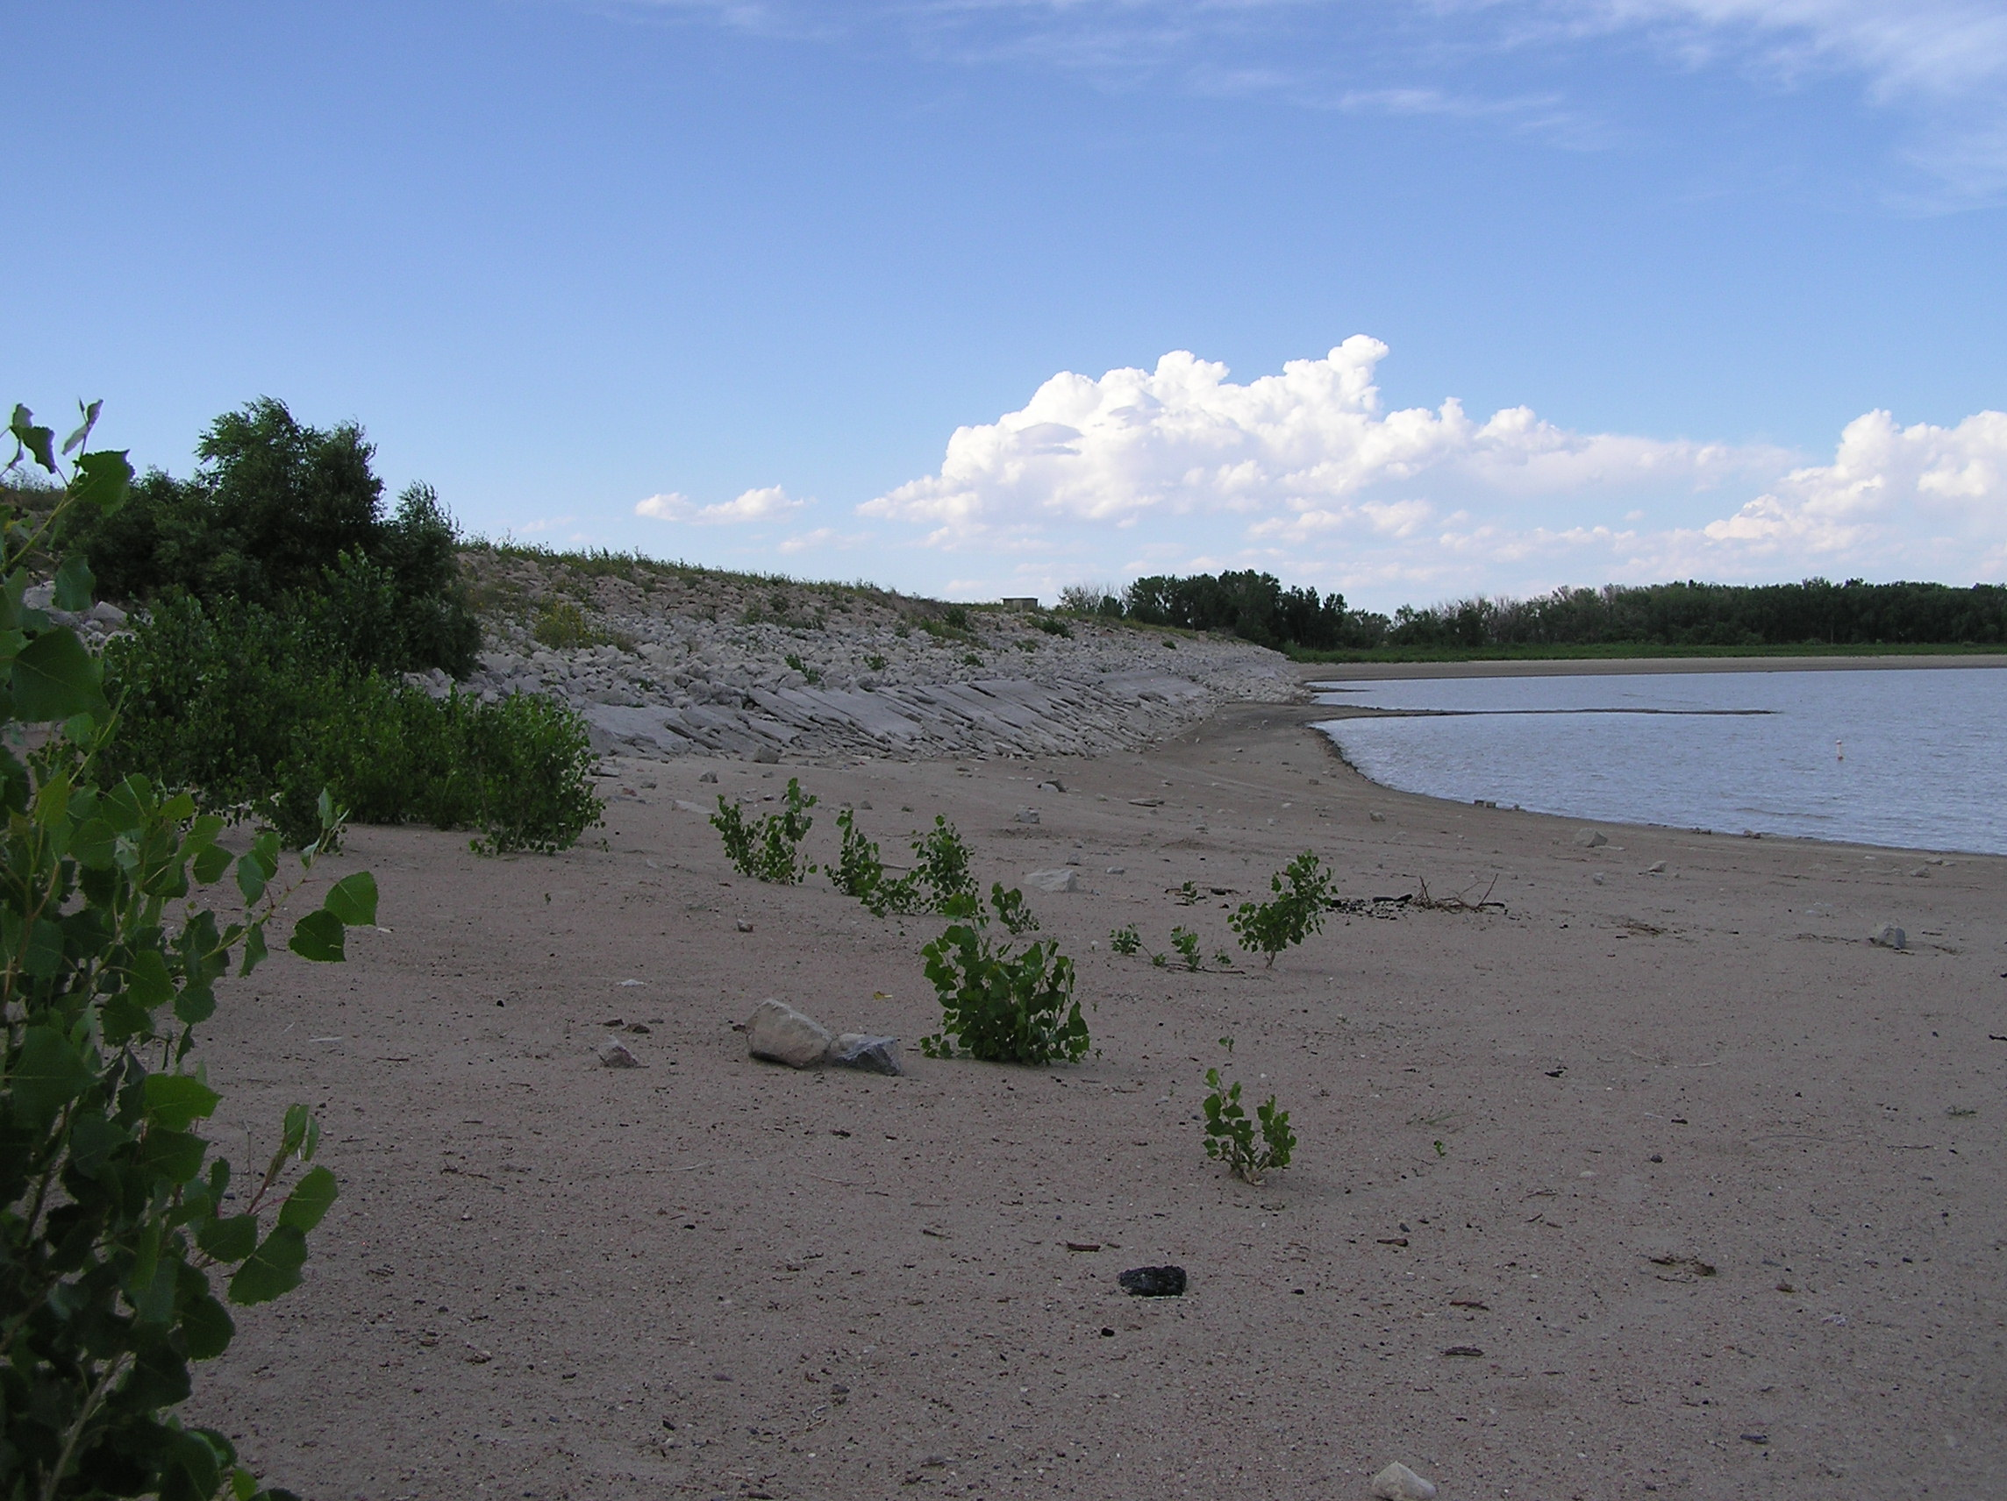
Reservoir Fishery Assessment Methods
Reservoir Quality Index
Demonstration Drawdown
Notes:
In a nationwide survey conducted by the Instream Flow Council that was published in 2009, only two methods capable of quantifying relationships between water volume amount and fisheries were identified. These included the Reservoir Quality Index developed by Witworth in Wyoming and based on the Morpho-edaphic index that was developed by Ryder in 1965. Both of these methods are based on a simple relationship between Total Dissolved Solids and Depth.
The other method referenced was the Demonstration Drawdown method that has been used in Ontario. This is a tool based on balancing outflow with inflow to match natural flow dynamics and processes and is essentially a variation of an adaptive management strategy.

Slide 46
Reservoir Model Considerations
Few fishery models to chose from
Most focus on fish production
Emphasize balance between riverine and reservoir uses
Need other tools to assess needs for riverine elements
Notes:
A key finding in this study is the relative paucity of methods to assess fishery values in reservoirs with the implication that fish and wildlife agencies are essentially willing to manage reservoirs with whatever water is provided. The issues of certainty and control (over water supply) do not appear very prominent on in their strategic planning for reservoir fisheries, which reveals an opportunity for managers to consider improving.

Slide 47
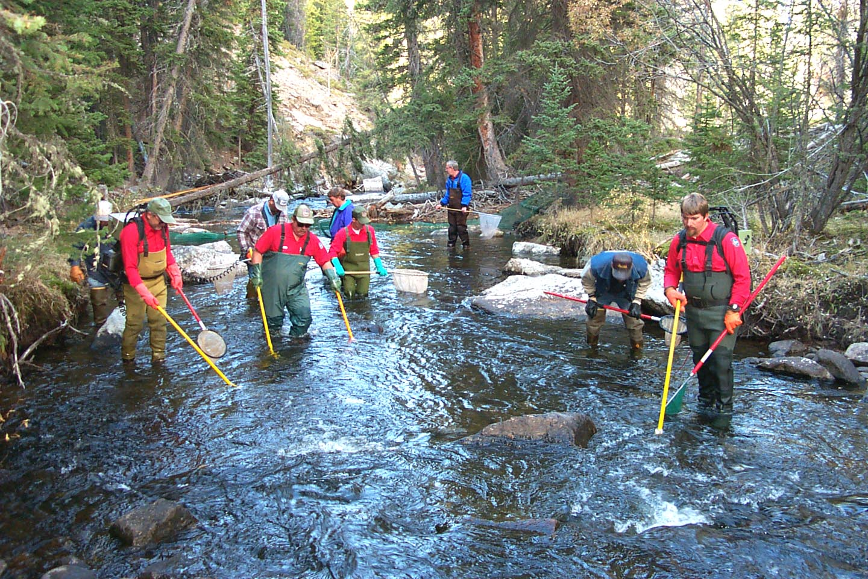
Empirical Methods
(Adaptive Management)
Notes:
Empirical methods for quantifying instream flow needs are essentially those based on direct observation and correlation of flow patterns with population trends. These may take one or more of several forms.

Slide 48
Adaptive management is a process
Establish Objectives
Implement Management
Monitor Effectiveness
Evaluate Results
Revise Management
© Instream Flow Council
Notes:
Adaptive management is perhaps the most widely recognized approach among the methods in this group. This approach sometimes finds favor because of the great amount of uncertainty inherent in determining instream flow needs, necessitating a strategy of putting recommendations to practice and see if they produce the desired outcome.
It is important to bear in mind that adaptive management is a long-term process. Successful implementation demands mutual, long-term commitment of all parties to a common goal, a clear definition of what is meant as to whether a prescription works, an active monitoring program, and the financial and administrative flexibility to accommodate evolving strategies as new information dictates. In the absence of these clear goals, strategies and measures of success, adaptive management may become nothing more than a stalling tactic until one side or the other gains an advantage (that may not necessarily be based on stream ecology).

Slide 49
Adaptive management requires:
Long-term commitment of all parties to a common (defined) goal,
A clear definition of what success looks like (dynamic vs. static; habitat vs. population)
Extensive monitoring before and after implementation of a flow prescription
Ability and resources (formal commitment, water & money) to implement new strategies when information shows the need.
Notes:
To be effective, adaptive management must incorporate these four specific components.

Slide 50
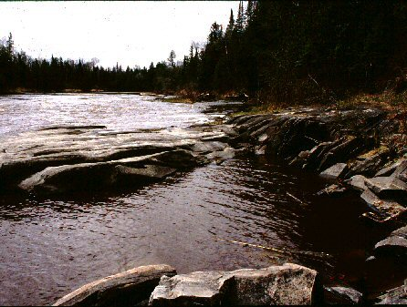
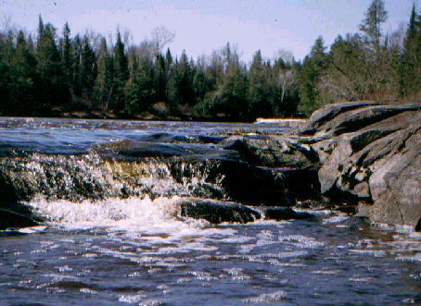
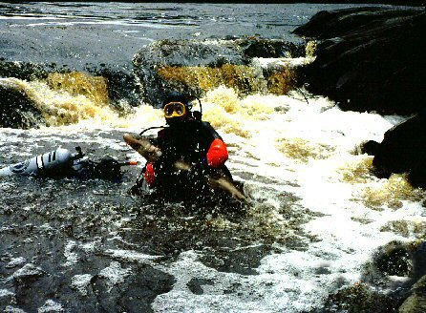
Pictures can be compelling
Notes:
In many situations, the public or high level administrators find technical charts, graphs and figures to be difficult to understand (and thus not very compelling). In at least some of those situations descriptive photographs can often tell the same story portrayed in more scientific data and make all the difference in whether a recommendation is accepted or not. Regardless, scientists should always take plenty of descriptive photos with the idea that such evidence may be much more effective that the most detailed technical model.

Slide 51
What about professional judgment?
Notes:
River and lake level management is all about understanding and interpreting data, processes, and outcomes. As such professional judgment is not only acceptable, it is essential. None of the technical methods described here or used anywhere in the world is capable of making decisions of flow or lake level management in the absence of objective interpretations. Technical tools help managers formulate decisions based on their extensive experience working with these complicated and dynamic natural resources. It’s unprofessional not to embrace credible professional judgment.

Slide 52
Monitoring
Typically focus on post-project monitoring
Adequate pre-project monitoring is essential
Can be a long-term commitment
Monitoring is not mitigation (unless tied to a regulatory action)
Notes:
Monitoring is often the one most important components that’s overlooked when quantifying and defending instream flow regime recommendations. It’s hard to know if you’ve accomplished your objectives if you don’t have an accurate understanding of how things looked and functioned before you started.
It’s important to remember that monitoring is not the same thing as mitigation unless it’s tied to some type of programmatic or regulatory action if unacceptable change is observed. If monitoring isn’t tied to a concrete outcome, biologists are relegated to documenting the demise of the resource they’re charged with managing.

Slide 53
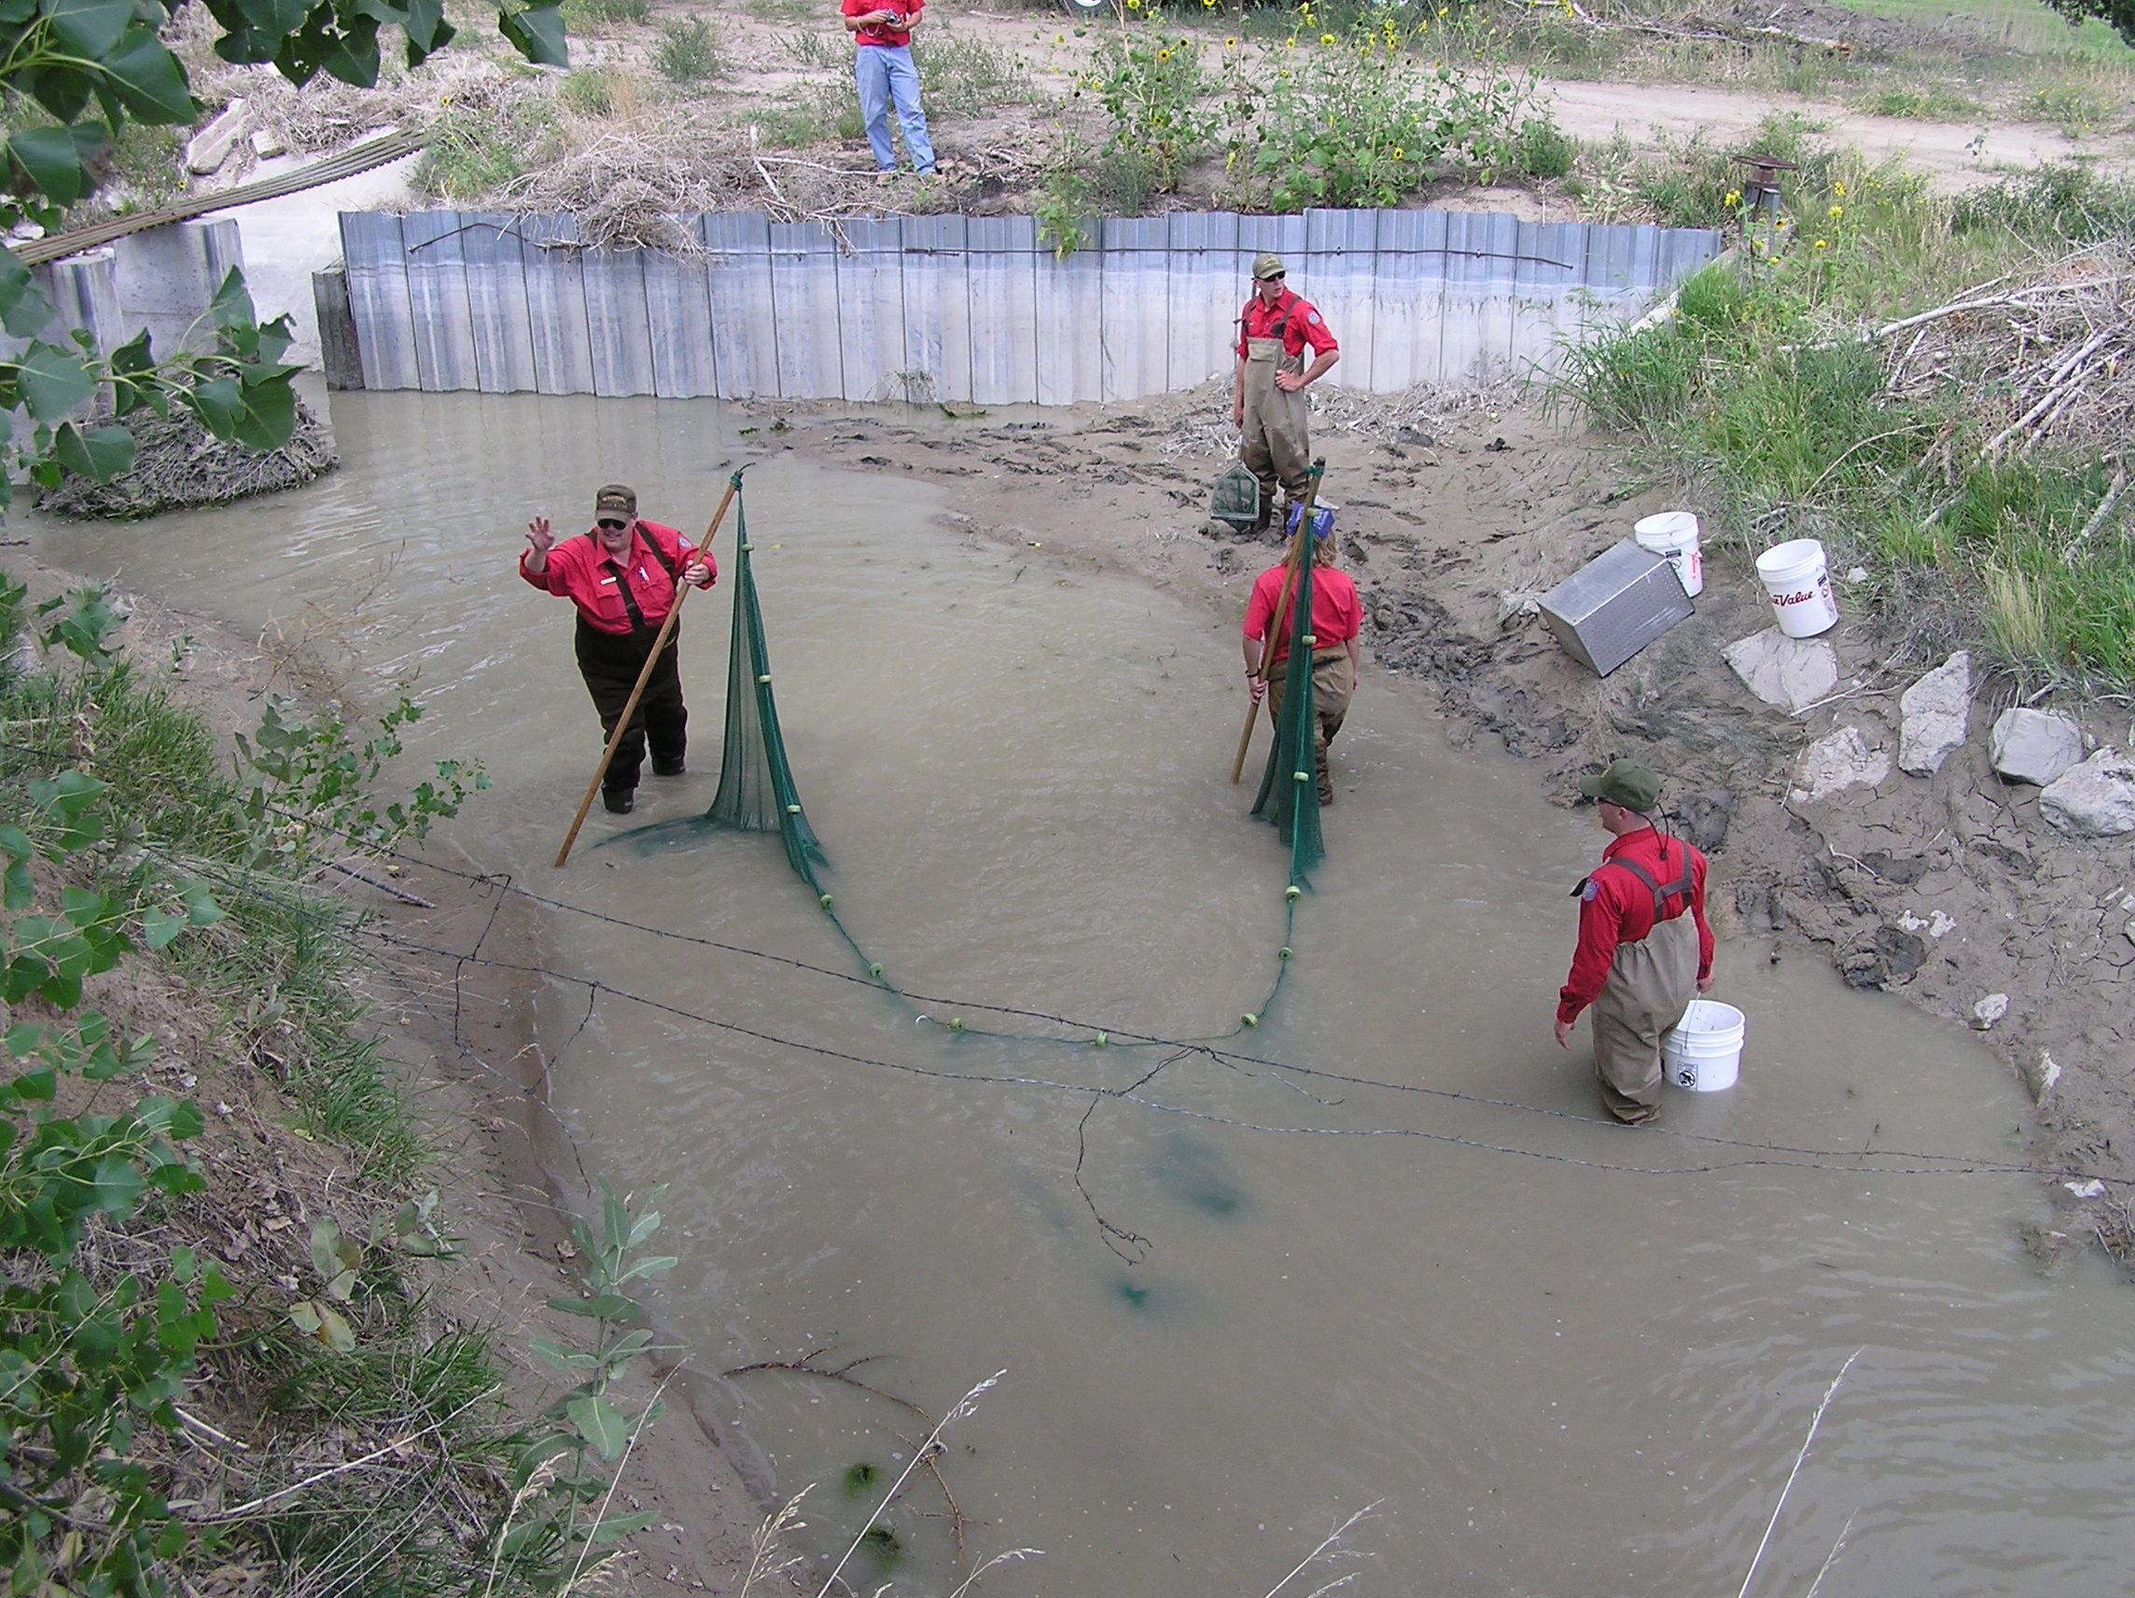
Monitor What?
Flow?
Organism abundance?
Community structure?
Habitat form and function?
Processes vs. snapshots?
Notes:
When we think of monitoring, we typically focus on the relatively easy things to keep track of. For example, if our goal is to improve numbers of a particular fish species we focus on a fish. But we often overlook monitoring the other elements of the stream upon which the organism of interest is highly dependent like habitat.
What’s more, we tend to focus on snapshots or one sample per month or year. This may work with things like water quality but doesn’t always work so well for organisms or habitat.
Nature is defined by processes, not static unchanging conditions. So where possible, monitoring should be geared to monitor process and define the dynamics of the river. We rarely find a constant condition in nature so we shouldn’t manage for one.

Slide 54
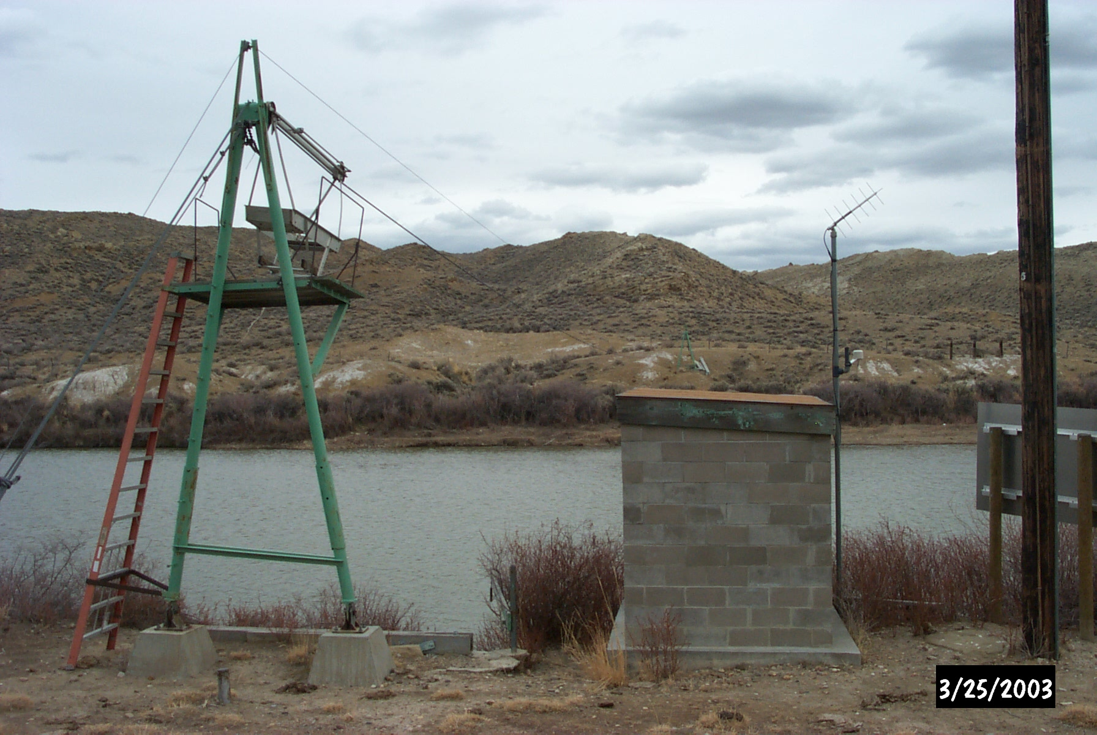
More gage data are always needed
Notes:
Of course the most important monitoring information needed is always more gage data. With shrinking budgets everywhere, the trend in operation of gages is negative, so there is a challenge to halt and reverse this trend where possible. Sometimes, it’s beneficial if agency staff can install inexpensive gaging devices such as continuously recording pressure transducers. Data from even a couple years of such data can sometimes be used to correlate with nearby permanent gages and synthesize a longer term hydrograph.

Slide 55
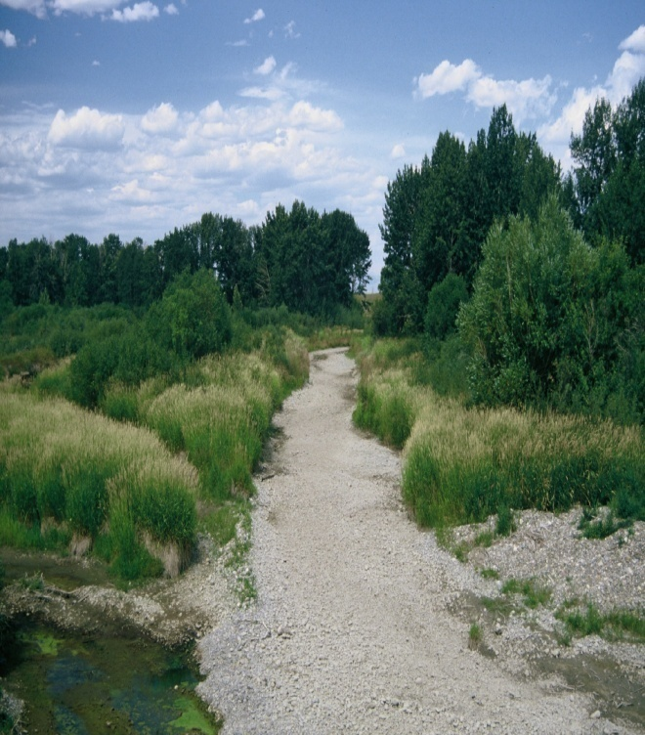
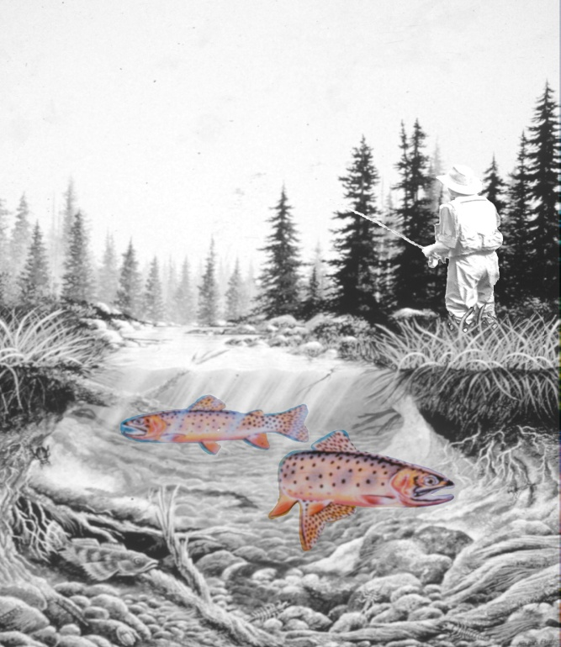

Putting it all together
Notes:
Exactly how do you move from dry or dysfunctional stream channels to managing for fish to managing for ecological processes of rivers? It really is a matter of putting together the pieces in whatever order you can.

Slide 56
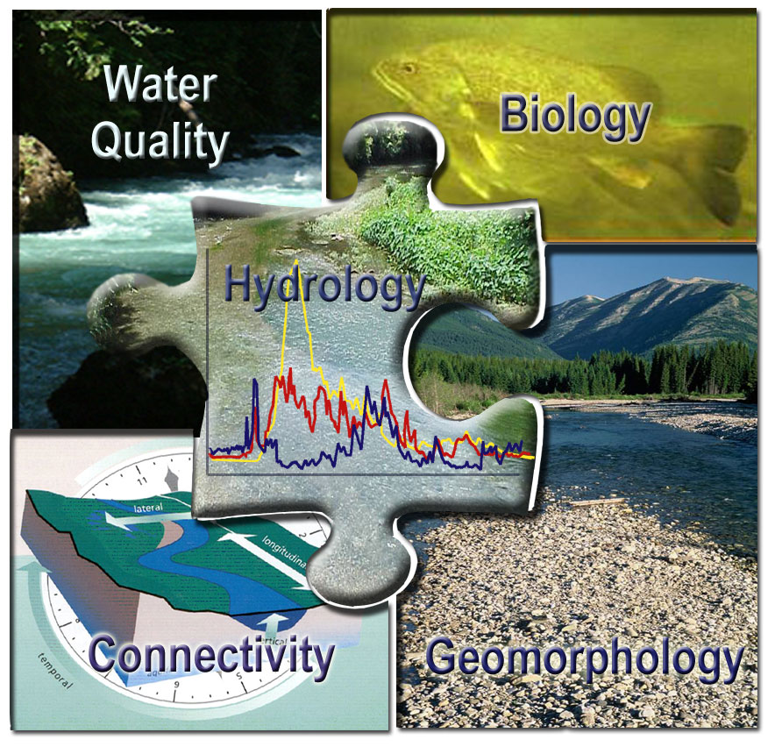
There is no best method
Long-term persistence of organisms comes from long-term persistence of habitat and habitat processes
© Instream Flow Council
Notes:
There’s no single method to answer this question, but there are a lot of good ones. Understanding how best to quantify flow needs often requires a good understanding of ecological complexity and almost always depends on a multi-disciplinary approach.

Slide 57
Notes:
One approach used in Alberta, Canada is to use a combination of methods or tools to address specific needs at specific times of year. This technique does not address inter-annual flow variation needs but does provide a reasonable intra-annual flow regime that addresses seasonal flow needs to some extent.
In this example, one would begin by establishing a base flow for the entire year below which no flow depletions would be allowed (bright red line). An appropriate fish habitat method is ussed for parts of the year when other higher flows are not appropriate (blue line). A channel maintenance flow regime is then identified to maintain high flows during the primary runoff period of year as a way to maintain in-channel habitat as well as riparian habitat.
Methods for connectivity could be employed at defined times of year if those needs were appropriate.

Slide 58
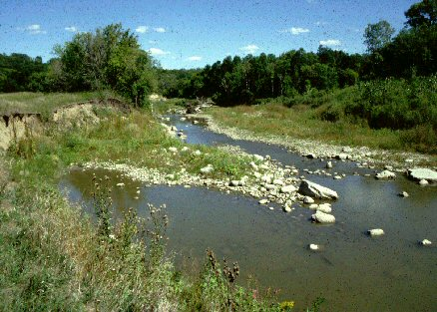
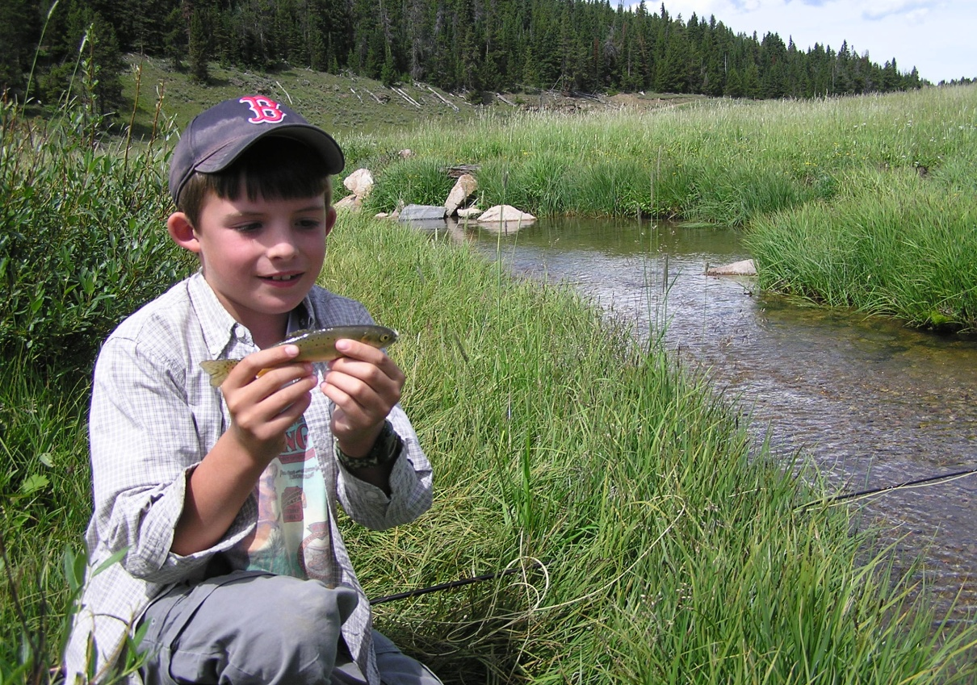
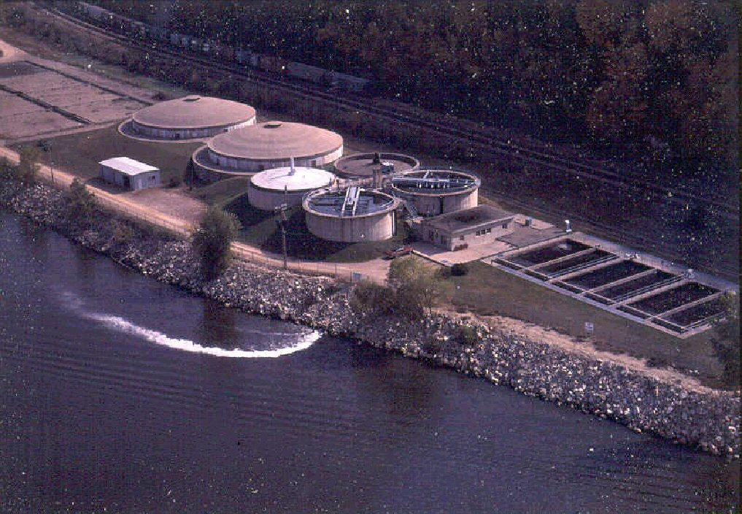
Science can ascertain what is, but not what should be, and outside of its domain value judgments of all kinds remain. Albert Einstein
Notes:
Science can provide a descriptive account of options but the model doesn’t exist that can make decisions for us. Those are generally matters of value that science simply isn’t intended to address. It can tell us what’s going on, but can’t make us do anything about it.
The entire equation for determining need must include other factors such as public demands, institutional capacity, and legal constraints.

